Slide 1
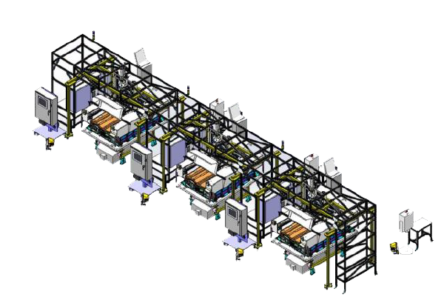
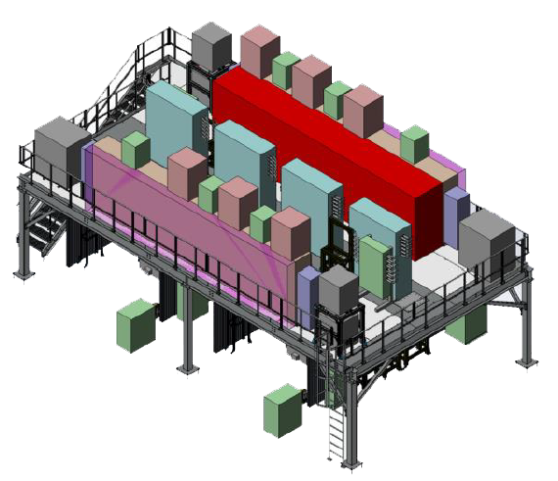
Battery Pack Test & Cover Leak Test & Pack Line
EP280 & EP580 & EP680
Operator Training Course
4 Hour Course – ½ Day

Slide 2
Introductions
Instructor: Bill Flatley

Slide 3
Safety Test and Review

Slide 4
System Safety
(At the Machine)

Slide 5
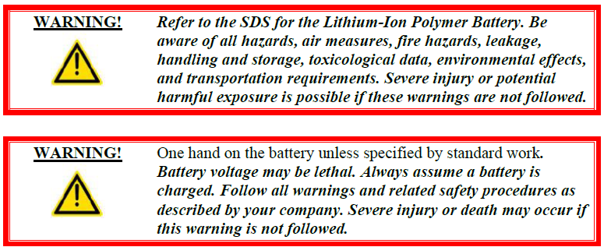
Battery Safety Overview
Assembly line personnel must comply with all safety rules.

Slide 6
Health & Safety
Statement

Slide 7
General Safety Guidelines
Read the Entire Manual
Good Work Habits
Consider Personal Health
Dress Properly
Clean and Safe Work Area
Safety Signage
ECPL Placard Locations
Use Tools Properly
Electrical System Safety
Mechanical System Safety
Operating Safety Precautions
Safety Devices

Slide 8
Personal Safety
Accidents often do not occur as the result of a single cause, but may occur because of an
interaction between working conditions, human error, and other events.
Knowledge First
Work Habits
Fitness for Duty
Dressing for Safety
Eye Protection
Hearing Protection
Head Protection
Foot Protection

Slide 9
Work Area Safety
Cleanliness
Warning Signs
Traffic Areas
Unsafe Conditions
Cell Guarding
Automated Guide Cart (AGC) Safety

Slide 10
ECPL Placards & Tags
Energy Control and Power Lockout

Slide 11
Tool Usage

Slide 12
Machine Safety
Electrical Safety
Pneumatic Safety
Mechanical Safety

Slide 13
Safety Device
Locations

Slide 14
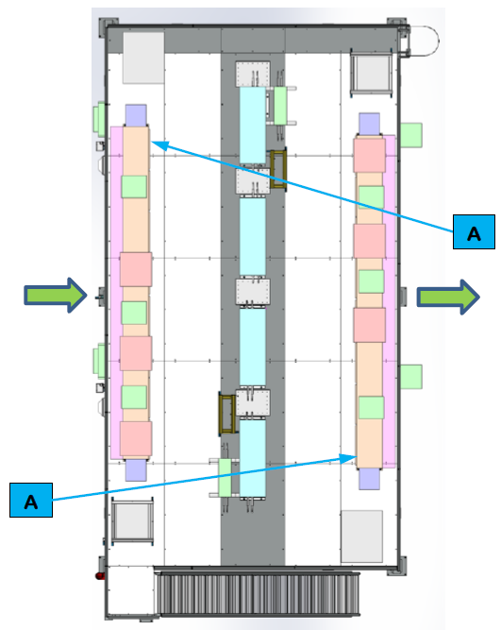
Safety Device Locations
for Cell EP280 and EP580 - Mezzanine

Slide 15
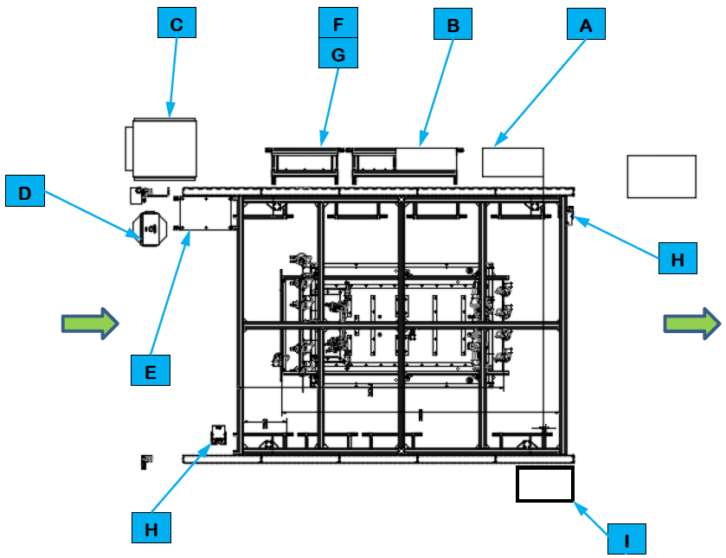
Safety Device Locations
for Cell EP280 and EP580 – Under Mezzanine

Slide 16
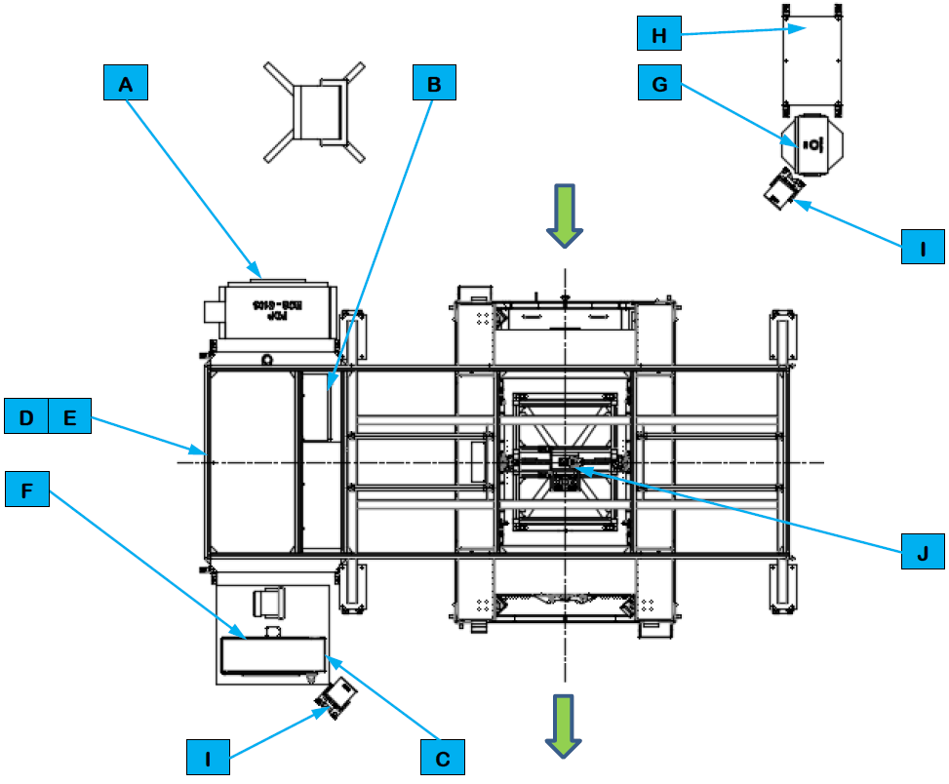
Safety Device Locations
for Cell EP680

Slide 17
Energy Control Devices

Slide 18
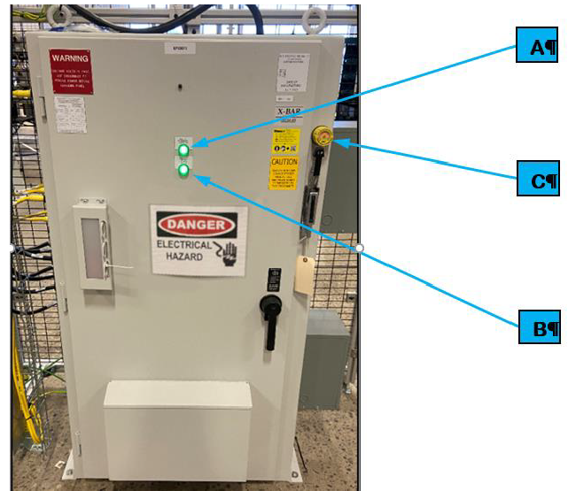
Cell Power Distribution Panel

Slide 19
Cell Main Pneumatic Disconnect
Each cell requires compressed air and has its own air processing equipment that
processes air supplied from the plant and distributes the processed air to the cell
equipment.

Slide 20
SDS References

Slide 21
Break

Slide 22
System
Description Overview
(At the Machine)

Slide 23
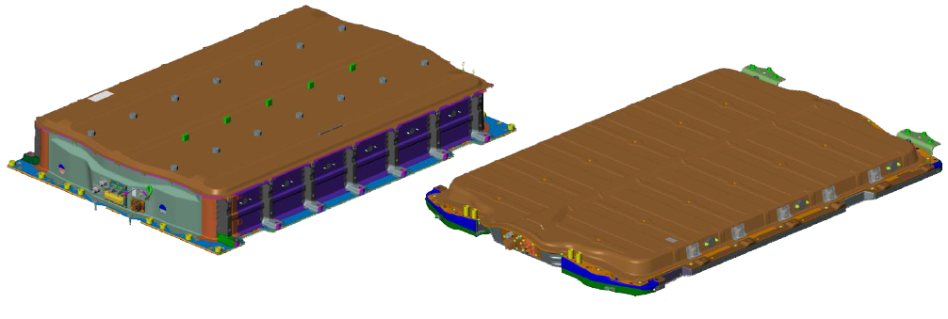
BET/BEV3 Battery Pack Test
and Cover Leak Test Summary
The BET/BEV3 Batter Pack Tests and Cover Leak Test are part of the Pack Main Line that
is part of a larger BET/BEV3 Battery Pack Assembly System.

Slide 24
The following lists the 13 battery assembly types handled by the Battery Pack Tests and
Cover Leak Test.
Pack Type | Assembly Type | Modules Per Assembly | Layers
BET | 24 Module Long Wheelbase Off-road | 24 | 2
BET | 24 Module Long Wheelbase | 24 | 2
BET | 20 Module Long Wheelbase Off-road | 20 | 2
BET | 20 Module Long Wheelbase | 20 | 2
BET | 16 Module Long Wheelbase | 16 | 2
BET | 10 Module Long Wheelbase | 10 | 2
BET | 20 Module Short Wheelbase Off-road | 20 | 2
BET | 20 Module Short Wheelbase | 20 | 2
BET | 16 Module Short Wheelbase | 16 | 2
BET | 12 Module Short Wheelbase | 12 | 2
BEV3 | 12 Module Rear Wheel Drive | 12 | 1
BEV3 | 12 Module All Wheel Drive | 12 | 1
BEV3 | 10 Module Rear Wheel Drive | 10 | 1

Slide 25
BET/BEV2 Battery Pack Test
and Cover Leak Test
System Layouts

Slide 26
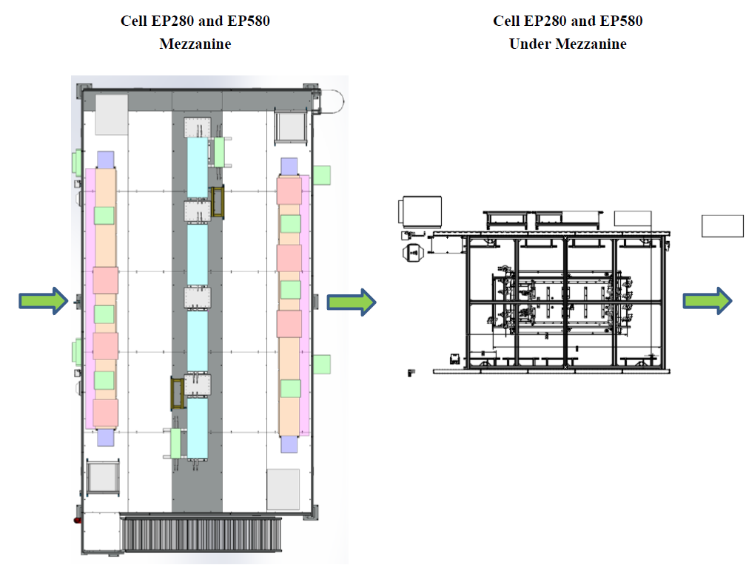
Battery Pack Test System Layout

Slide 27
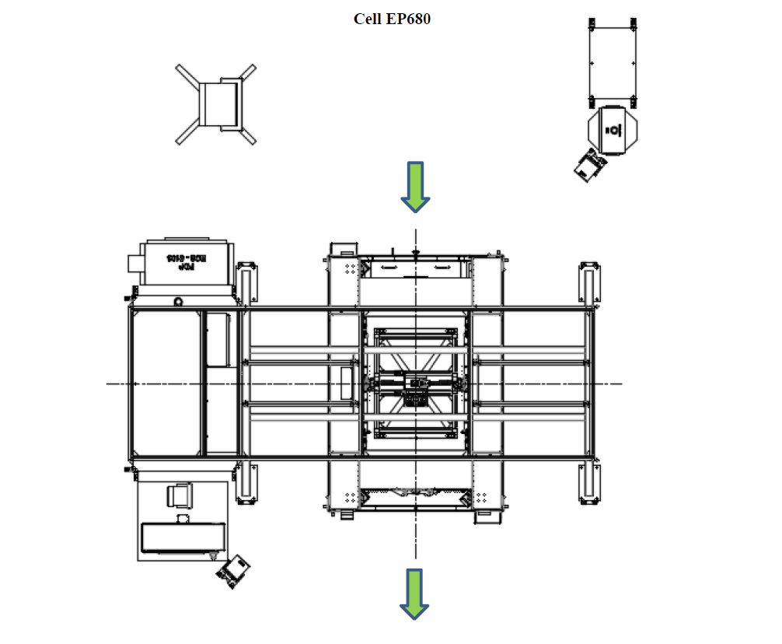
Cover Leak Test System Layout

Slide 28
BET/BEV2 Battery Pack Test
and Cover Leak Test
Utilities

Slide 29
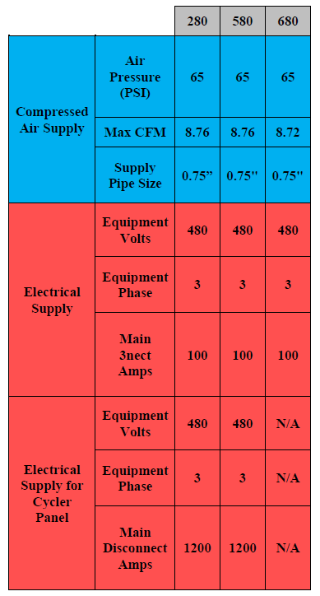
Battery Pack Test and
Cover Leak Test Utilities – Manual Stations

Slide 30
BET/BEV2 Battery Pack Test
and Cover Leak Test
Equipment

Slide 31
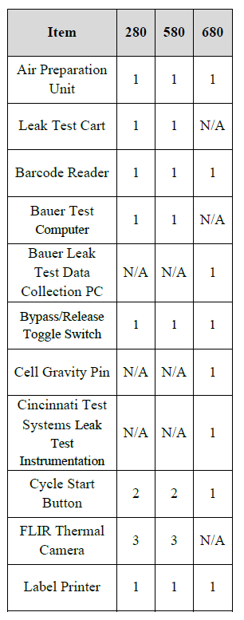
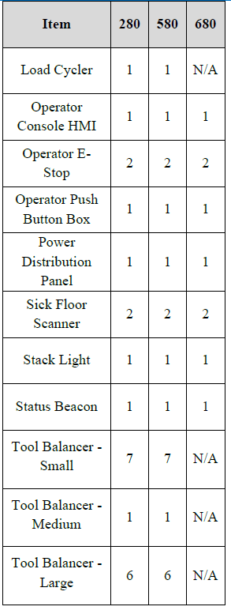
Equipment Matrix – Manual Stations

Slide 32
Common Equipment

Slide 33
Air Preparation Unit

Slide 34
Automated Guided Cart (AGC)

Slide 35
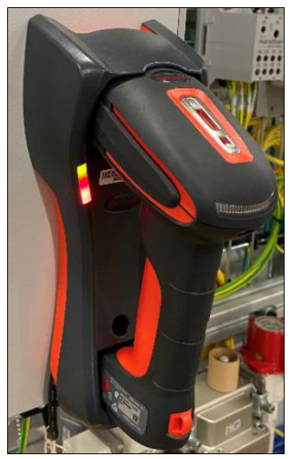
Barcode Reader

Slide 36
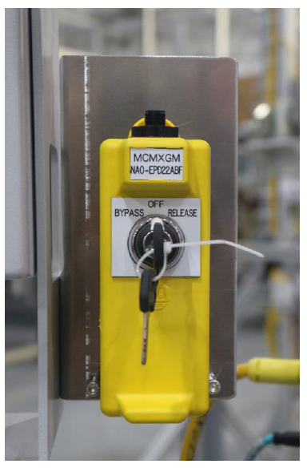
Bypass/Release Toggle Switch

Slide 37
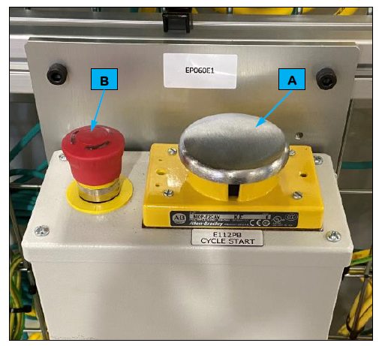
Cycle Start Button

Slide 38
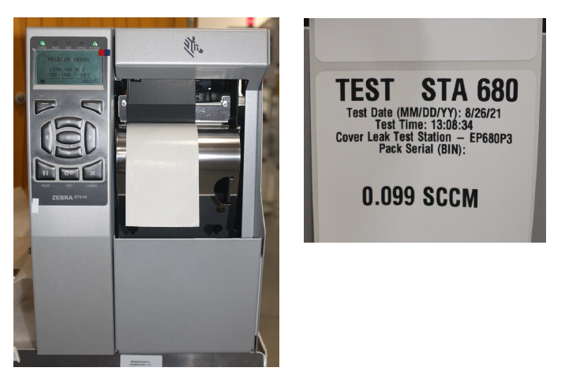
Label Printer

Slide 39
Electrical and Coolant Leak
Test Station EP280 and EP580
Equipment

Slide 40
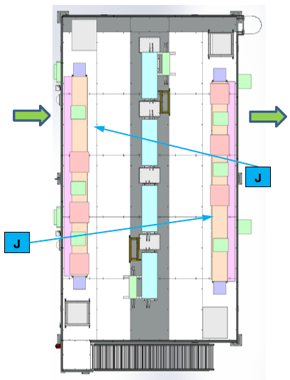
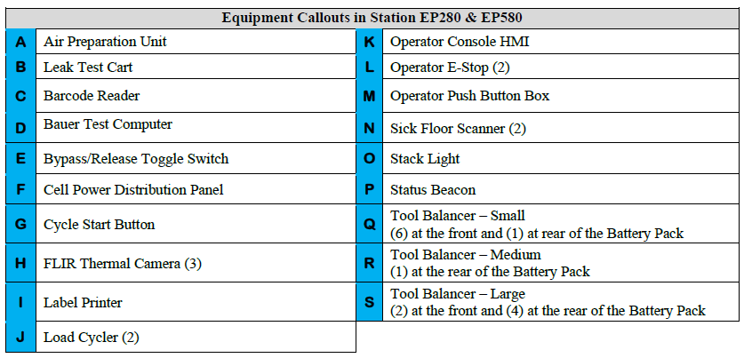
Cell EP280 and EP580 – Mezzanine (1 of 3)
TOP VIEW

Slide 41
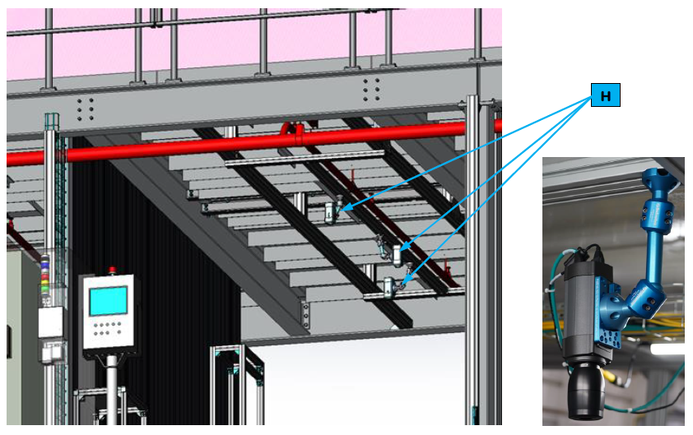
Cell EP280 and EP580 – Mezzanine (2 of 3)
TOP VIEW

Slide 42
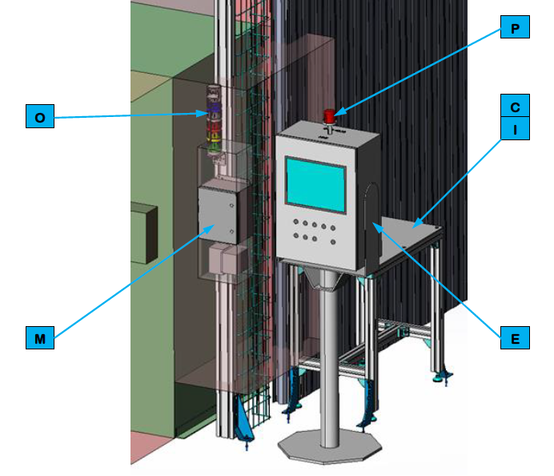
Cell EP280 and EP580 – Mezzanine (3 of 3)
TOP VIEW

Slide 43
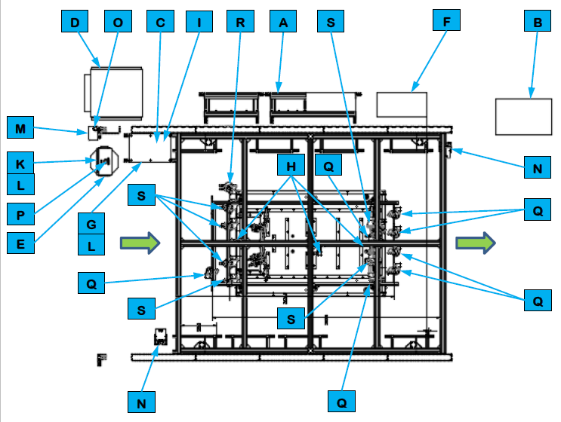
Cell EP280 and EP580 – Under Mezzanine
TOP VIEW

Slide 44
Cell EP280 & EP580
Sequence of Operations

Slide 45
Leak Test Cart
The Leak Test Cart pressurizes the batter pack coolant circuit and determines if it is leak
Tight using a differential pressure decay test method.

Slide 46
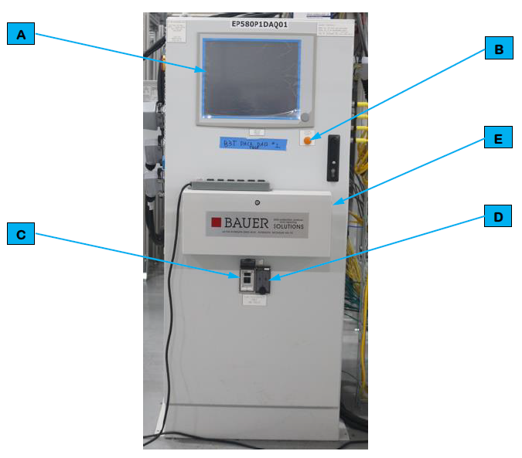
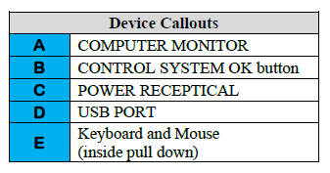
Bauer Test Computer

Slide 47
FLIR Thermal Camera
The FLIR Thermal Cameras detect heat.

Slide 48
Load Cycler
The Cell Load Cycler charges and discharges the Battery Pack for the electrical test
and is controlled by the Baur Test Computer.

Slide 49
Tool Balancer - Small
The Tool Balancer is an adjustable cable system suspended from the cell frame that allows
tools to hang within reach of the Operator.

Slide 50
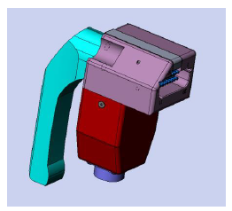
BEV3 X1 LV Connector

Slide 51
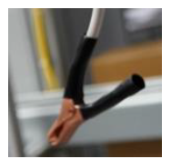
BET / BEV3 Ground Connector 1
BET Ground Connector 2

Slide 52
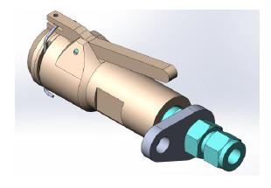
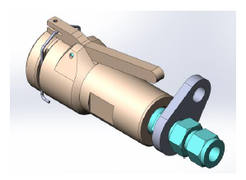
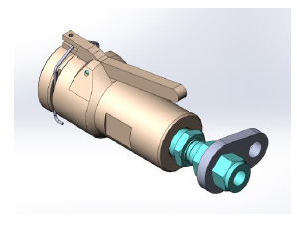
BEV3 Outlet Coolant Connector
BET Outlet / BEV3 Inlet Coolant Connector
BET Inlet Coolant Connector

Slide 53
BET Heater Connector & BET ACEC Connector

Slide 54
Tool Balancer - Medium
The Tool Balancer is an adjustable cable system suspended from the cell frame that allows
tools to hang within reach of the Operator.

Slide 55
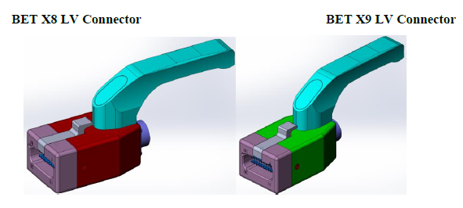
BET X8 LV Connector & BET X9 LV Connector

Slide 56
Tool Balancer - Large
The Tool Balancer is an adjustable cable system suspended from the cell frame that allows
tools to hang within reach of the Operator.

Slide 57
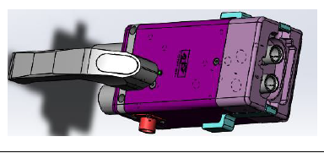
BEV3 DCFC Connector

Slide 58
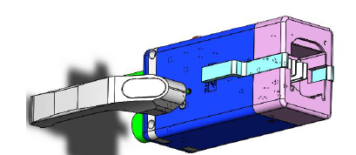
BET FPIM / BEV3 IPE Connector

Slide 59
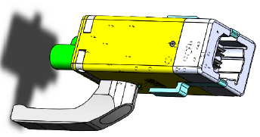
BET LPIM Connector

Slide 60
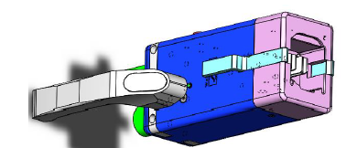
BET RPIM Connector

Slide 61
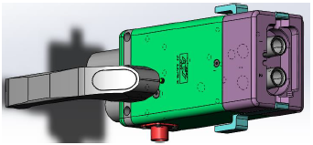
BET DCFC Connector

Slide 62
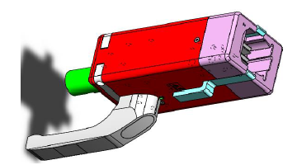
BET IPE / BEV3 RDU Connector

Slide 63
Cover Leak Test Station
EP680 Equipment

Slide 64
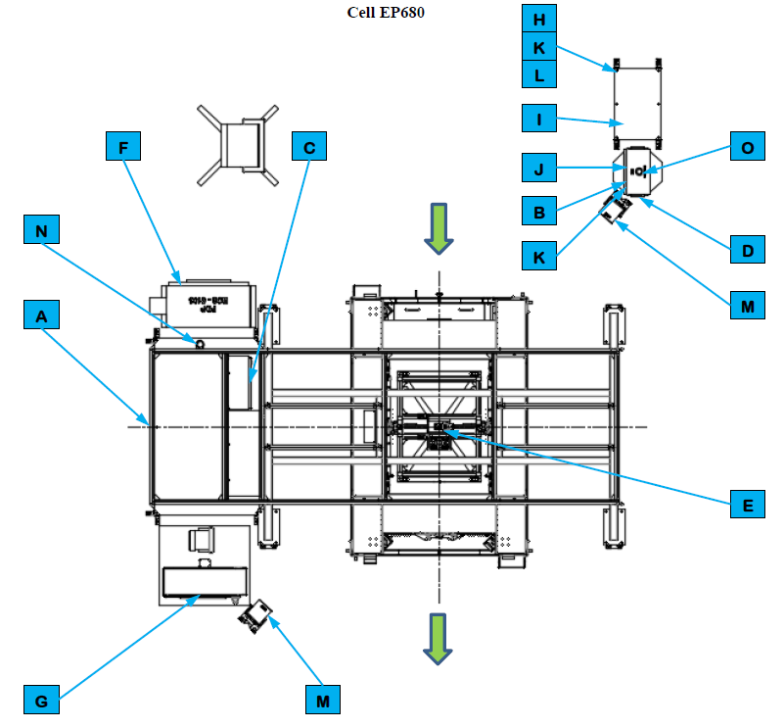
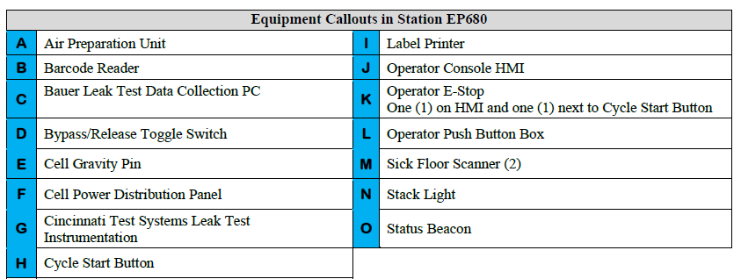
Cell EP680 (1 of 2)

Slide 65
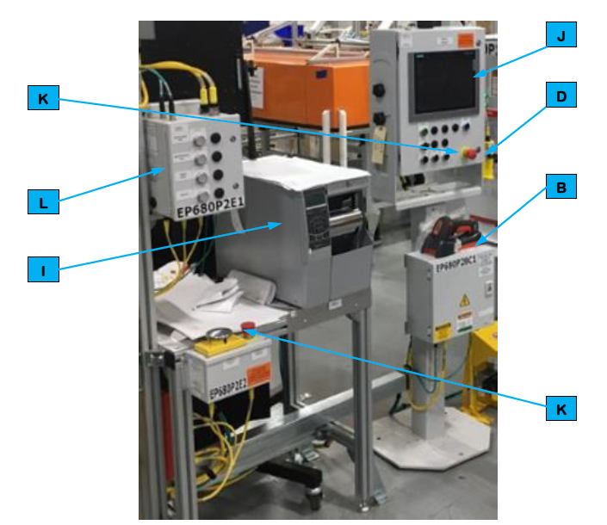
Cell EP680 (2 of 2)

Slide 66
Cell EP680
Sequence of Operations

Slide 67
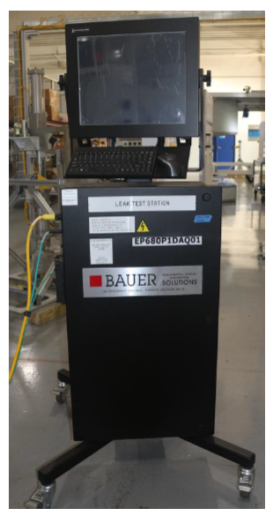
EP680 Bauer Leak Test Data Collection PC

Slide 68
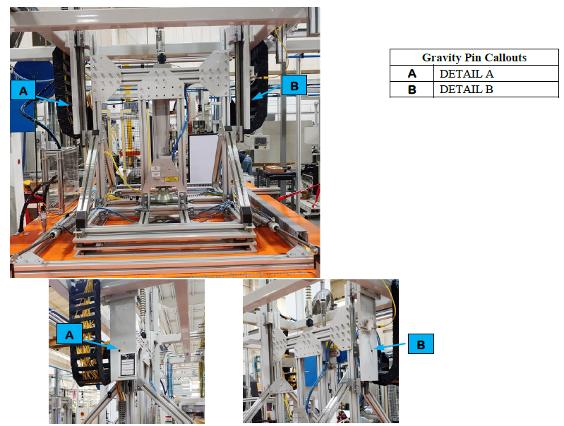
Cell Gravity Pin

Slide 69
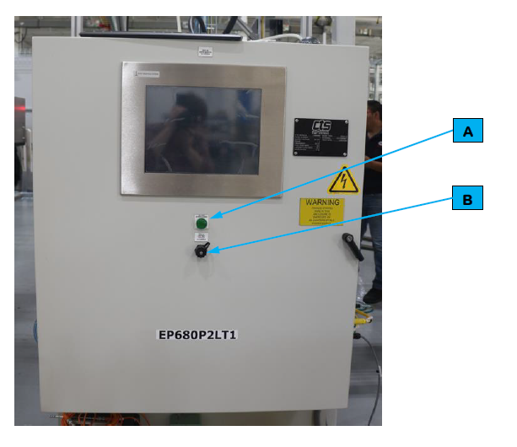
Cincinnati Test Systems Leak Test Instrumentation

Slide 70
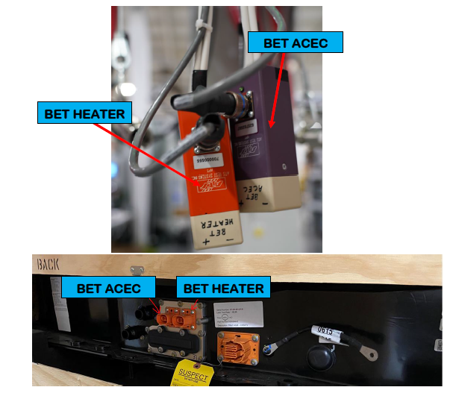
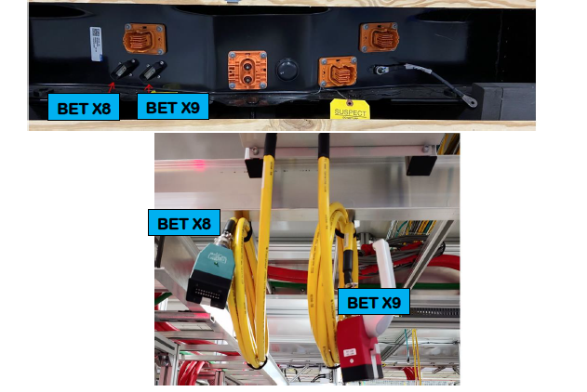
BET Heater & ACEC Header Plug

Slide 71
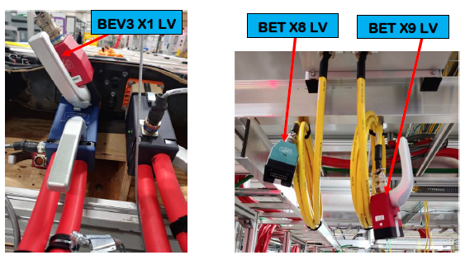
BET / BEV LV Header Plug

Slide 72
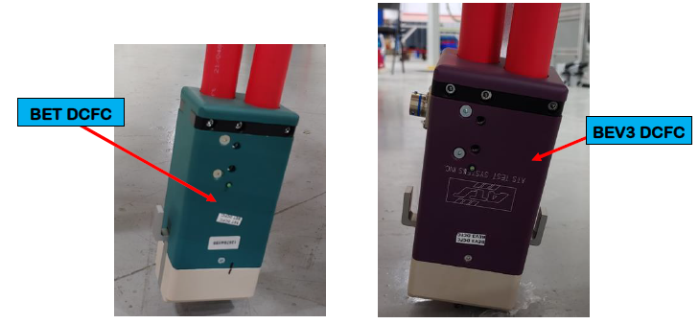
BET / BEV DCFC Header Plug

Slide 73
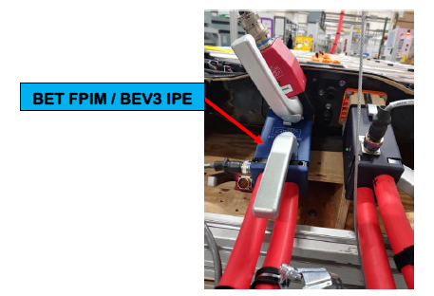
BET / BEV HV Header Plug

Slide 74
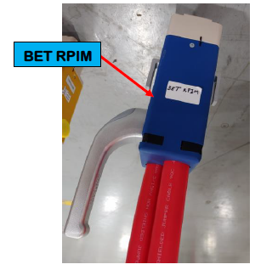
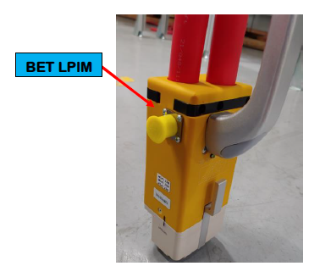
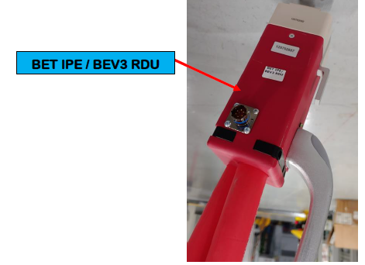
BET / BEV HV Header Plug

Slide 75
Hood Assembly

Slide 76
BET Vacuum Connector

Slide 77
BEV3 Vacuum Connector

Slide 78
Unico Drive Removal Cart

Slide 79
Cover Leak Solenoid Valve

Slide 80
Operating
Instructions

Slide 81
Operator Interface Devices

Slide 82
Interface Device Table – Manual Stations

Slide 83
Barcode Reader

Slide 84
Bypass/Release Toggle Switch

Slide 85
Cycle Start Button

Slide 86
Label Printer

Slide 87
Controls and Indicators

Slide 88
Operator Console Human Machine Interface (HMI)

Slide 89
Operator Emergency Stop (E-Stop)

Slide 90
Operator Push Button Box
Button | Description
RESPONDER CALL | Call a Team Lead.
MAINTENANCE CALL | Call Maintenance Personnel.
PRINT LABEL | Reprint a label if the original printed label is damaged.
RETEST | NOT USED.

Slide 91
Cell Power Distribution Panel

Slide 92
SICK Safety Laser Scanner

Slide 93
Stack Light
Indicator | Action | Description
Horn | Multiple Beeps | Notification Alert
Horn | One Beep | Scan Passed
Blue | Flashing | Operator Load Prompt
Blue | Fast Flashing | N/A
Blue | Solid | In Cycle
White | Flashing | Flexnet Gate Check Query in Progress
White | Fast Flashing | Flexnet Gate Check Failed
White | Solid | Flexnet Gate Check Passed
Red | Flashing | N/A
Red | Fast Flashing | Maintenance Call
Red | Solid | Station Faulted
Yellow | Flashing | Over Cycle
Yellow | Fast Flashing | Responder Call
Yellow | Solid | Approaching End of Cycle
Green | Flashing | Ready for Cycle
Green | Fast Flashing | N/A
Green | Solid | Process Complete

Slide 94
Status Beacon
Indicator | Action | Description
Red | Flashing | Maintenance (High Priority Fault) Alarm Present
Red | Solid | Non-Maintenance (Low Priority Fault) Alarm Present

Slide 95
EP680 Bauer Leak Test Data Collection PC

Slide 96
Cincinnati Test Systems Leak Test Instrumentation

Slide 97
HMI Screens

Slide 98
HMI Screen Navigation Paths

Slide 99
Screen Header

Slide 100
Select Screen

Slide 101
Mode Screen

Slide 102
Scroll List Screen

Slide 103
DAQ Interlock Screen

Slide 104
Station Overview Screen

Slide 105
Cell Overview Screen

Slide 106
Cell Power and I/O Screen

Slide 107
Barcode Screen

Slide 108
EtherNet Public Screen

Slide 109
Switch Ports and Devices Screen

Slide 110
Switch Status Screen

Slide 111
EtherNet Private Screen

Slide 112
Linear Network Screen

Slide 113
Device Details Screen

Slide 114
Alarm Screen

Slide 115
Maintenance History Screen

Slide 116
Cycle Time Screen

Slide 117
Station Throughput Screen

Slide 118
Configuration Screen

Slide 119
Signature Screen

Slide 120
Style Overview Screen

Slide 121
Style Overview Edit Data Screen

Slide 122
Quality Screen

Slide 123
Common Operating Procedures

Slide 124
Starting Cell in Manual Mode

Slide 125
Starting Cell in Automatic Mode

Slide 126
Shutting Down

Slide 127
Recovering from an Emergency Stop

Slide 128
Recovering from a Fault

Slide 129
Mastering Sequence for Pack Coolant Leak Test

Slide 130
Mastering Sequence for Pack Cover Leak Test

Slide 131
Auto Mode

Slide 132
Manual Mode

Slide 133
Hands On
(At the Machine)

Slide 134
HMI Screens

Slide 135
HMI Screen Navigation Paths

Slide 136
Screen Header

Slide 137
Select Screen

Slide 138
Mode Screen

Slide 139
Scroll List Screen

Slide 140
DAQ Interlock Screen

Slide 141
Station Overview Screen

Slide 142
Cell Overview Screen

Slide 143
Cell Power and I/O Screen

Slide 144
Barcode Screen

Slide 145
EtherNet Public Screen

Slide 146
Switch Ports and Devices Screen

Slide 147
Switch Status Screen

Slide 148
EtherNet Private Screen

Slide 149
Linear Network Screen

Slide 150
Device Details Screen

Slide 151
Alarm Screen

Slide 152
Maintenance History Screen

Slide 153
Cycle Time Screen

Slide 154
Station Throughput Screen

Slide 155
Configuration Screen

Slide 156
Signature Screen

Slide 157
Style Overview Screen

Slide 158
Style Overview Edit Data Screen

Slide 159
Quality Screen

Slide 160
Common Operating Procedures

Slide 161
Starting Cell in Manual Mode

Slide 162
Starting Cell in Automatic Mode

Slide 163
Shutting Down

Slide 164
Recovering from an Emergency Stop

Slide 165
Recovering from a Fault

Slide 166
Mastering Sequence for Pack Coolant Leak Test

Slide 167
Mastering Sequence for Pack Cover Leak Test

Slide 168
Modes of Operation

Slide 169
Manual Station
Operation

Slide 170
Automated Station
Operation – Auto Mode

Slide 171
Automated Station
Operation – Manual Mode

Slide 172
Entering Manual Mode

Slide 173
Tryout Mode

Slide 174
Runout Mode

Slide 175
End of Cycle Hold Mode

Slide 176
Class Wrap-Up
Closing Remarks
Complete Course Evaluations

