Slide 1
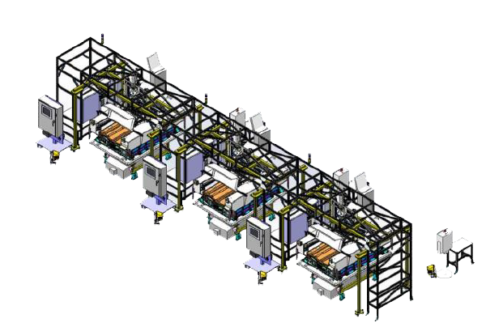
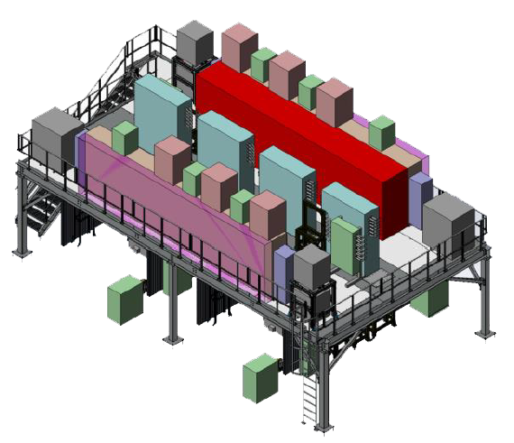
Battery Pack Test & Cover Leak Test & Pack Line
EP280 & EP580 & EP680
Mechanical Training Course
8 Hour Course – 1 Day

Slide 2
Introductions
Instructor: Bill Flatley

Slide 3
System Safety

Slide 4
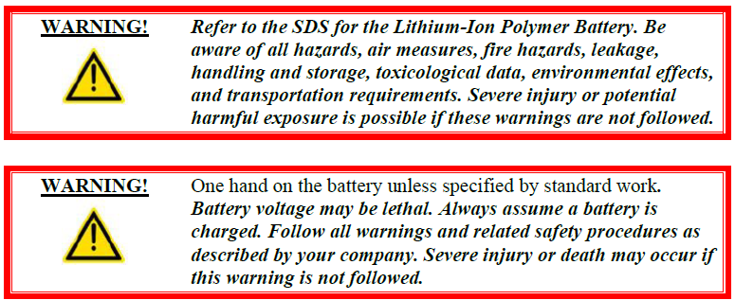
Battery Safety Overview
Assembly line personnel must comply with all safety rules.

Slide 5
Health & Safety
Statement

Slide 6
General Safety Guidelines
Read the Entire Manual
Good Work Habits
Consider Personal Health
Dress Properly
Clean and Safe Work Area
Safety Signage
ECPL Placard Locations
Use Tools Properly
Electrical System Safety
Mechanical System Safety
Operating Safety Precautions
Safety Devices

Slide 7
Personal Safety
Accidents often do not occur as the result of a single cause, but may occur because of an
interaction between working conditions, human error, and other events.
Knowledge First
Work Habits
Fitness for Duty
Dressing for Safety
Eye Protection
Hearing Protection
Head Protection
Foot Protection

Slide 8
Work Area Safety
Cleanliness
Warning Signs
Traffic Areas
Unsafe Conditions
Cell Guarding
Automated Guide Cart (AGC) Safety

Slide 9
ECPL Placards & Tags
Energy Control and Power Lockout

Slide 10
Tool Usage

Slide 11
Machine Safety
Electrical Safety
Pneumatic Safety
Mechanical Safety

Slide 12
Safety Device
Locations

Slide 13
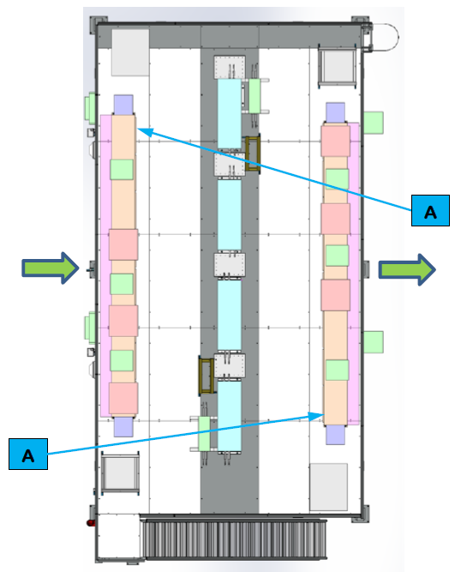
Safety Device Locations
for Cell EP280 and EP580 - Mezzanine

Slide 14
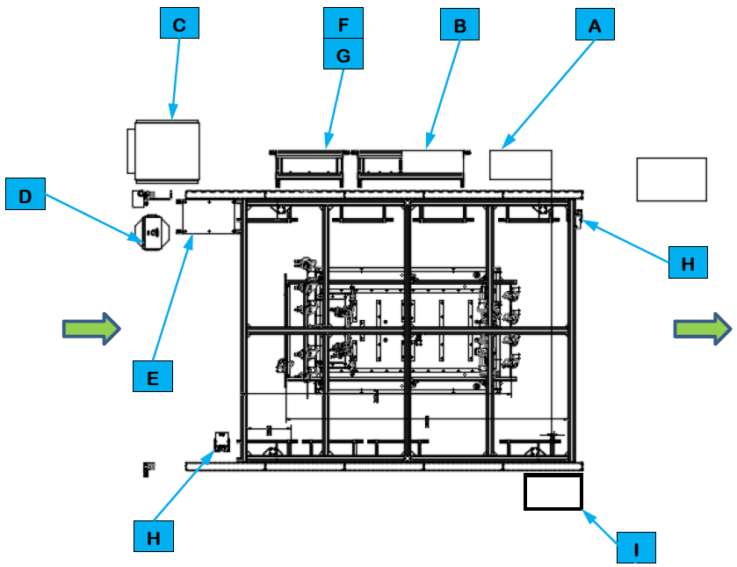
Safety Device Locations
for Cell EP280 and EP580 – Under Mezzanine

Slide 15
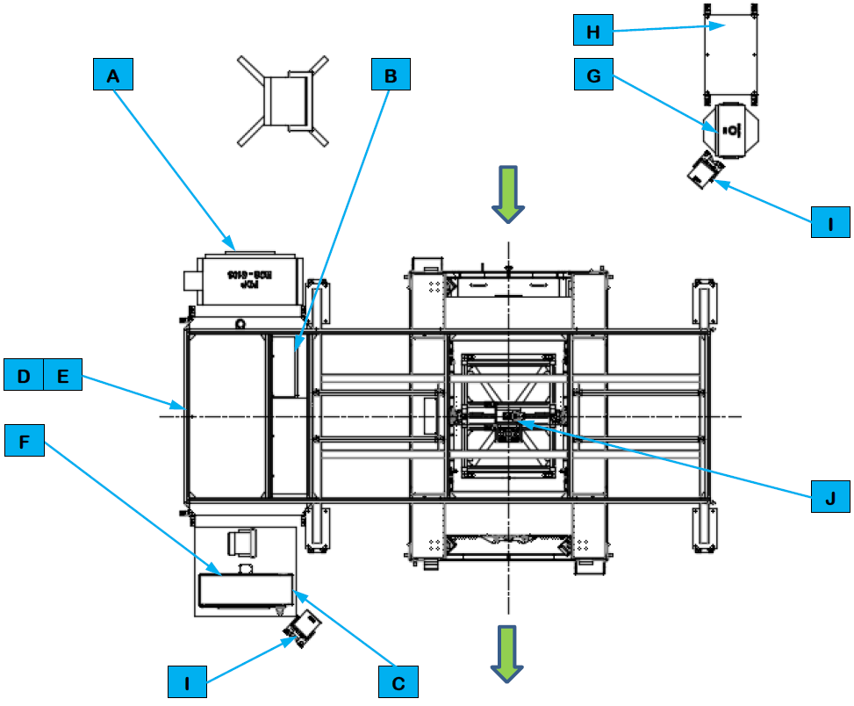
Safety Device Locations
for Cell EP680

Slide 16
Energy Control Devices

Slide 17
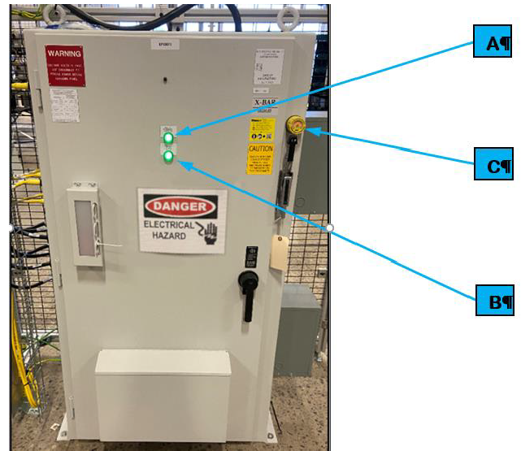
Cell Power Distribution Panel

Slide 18
Cell Main Pneumatic Disconnect
Each cell requires compressed air and has its own air processing equipment that
processes air supplied from the plant and distributes the processed air to the cell
equipment.

Slide 19
SDS References

Slide 20
System
Description Overview
(At the Machine)

Slide 21
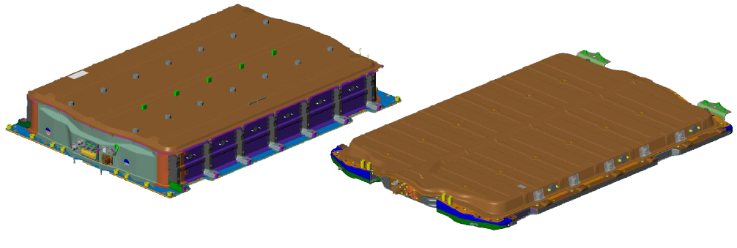
BET/BEV3 Battery Pack Test
and Cover Leak Test Summary
The BET/BEV3 Batter Pack Tests and Cover Leak Test are part of the Pack Main Line that
is part of a larger BET/BEV3 Battery Pack Assembly System.

Slide 22
The following lists the 13 battery assembly types handled by the Battery Pack Tests and
Cover Leak Test.
Pack Type | Assembly Type | Modules Per Assembly | Layers
BET | 24 Module Long Wheelbase Off-road | 24 | 2
BET | 24 Module Long Wheelbase | 24 | 2
BET | 20 Module Long Wheelbase Off-road | 20 | 2
BET | 20 Module Long Wheelbase | 20 | 2
BET | 16 Module Long Wheelbase | 16 | 2
BET | 10 Module Long Wheelbase | 10 | 2
BET | 20 Module Short Wheelbase Off-road | 20 | 2
BET | 20 Module Short Wheelbase | 20 | 2
BET | 16 Module Short Wheelbase | 16 | 2
BET | 12 Module Short Wheelbase | 12 | 2
BEV3 | 12 Module Rear Wheel Drive | 12 | 1
BEV3 | 12 Module All Wheel Drive | 12 | 1
BEV3 | 10 Module Rear Wheel Drive | 10 | 1

Slide 23
BET/BEV2 Battery Pack Test
and Cover Leak Test
System Layouts

Slide 24
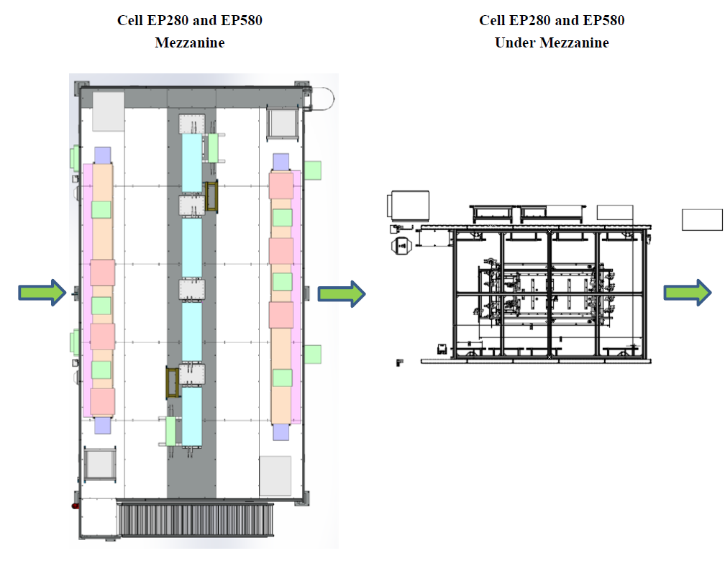
Battery Pack Test System Layout

Slide 25
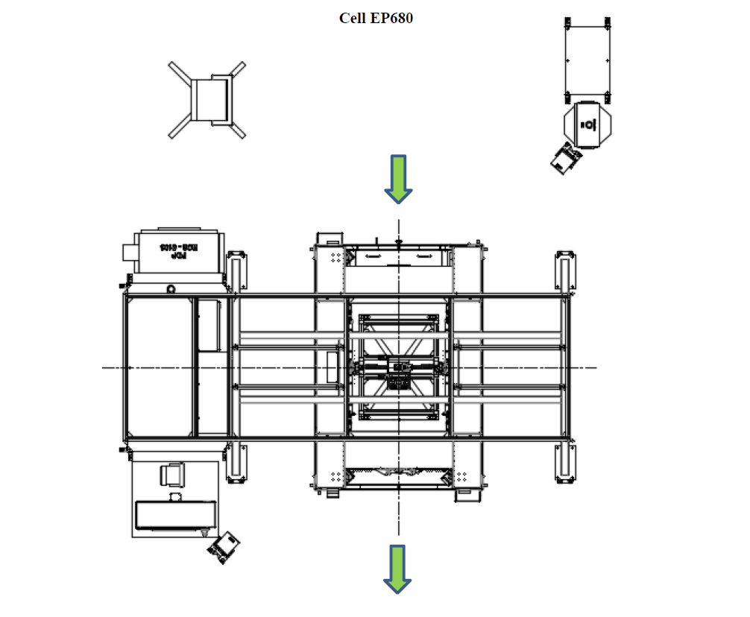
Cover Leak Test System Layout

Slide 26
BET/BEV2 Battery Pack Test
and Cover Leak Test
Utilities

Slide 27
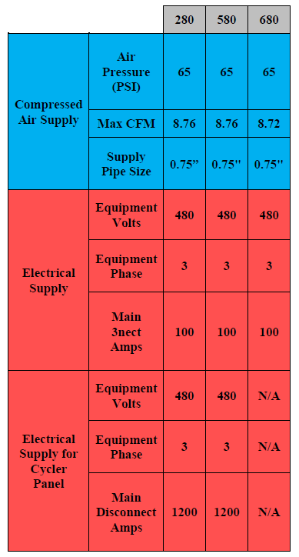
Battery Pack Test and
Cover Leak Test Utilities – Manual Stations

Slide 28
BET/BEV2 Battery Pack Test
and Cover Leak Test
Equipment

Slide 29
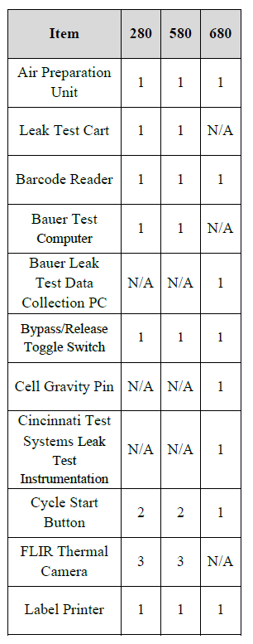
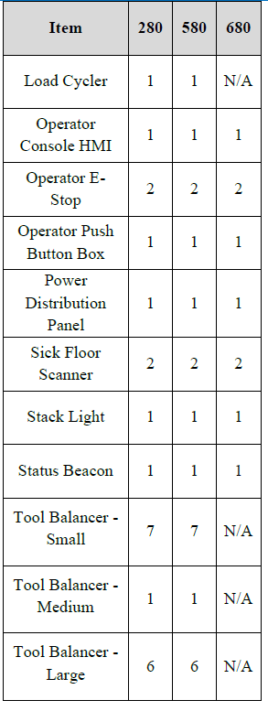
Equipment Matrix – Manual Stations

Slide 30
Common Equipment

Slide 31
Air Preparation Unit

Slide 32
Automated Guided Cart (AGC)

Slide 33
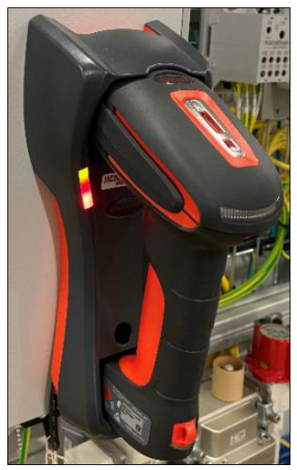
Barcode Reader

Slide 34
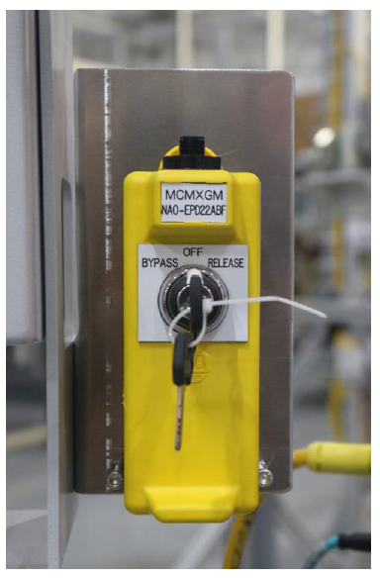
Bypass/Release Toggle Switch

Slide 35
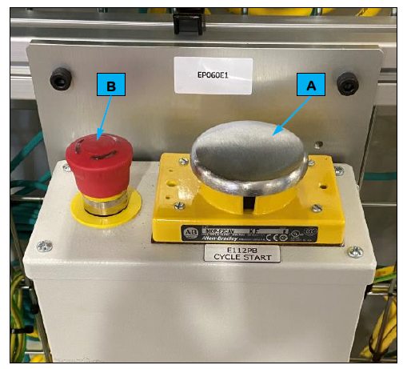
Cycle Start Button

Slide 36
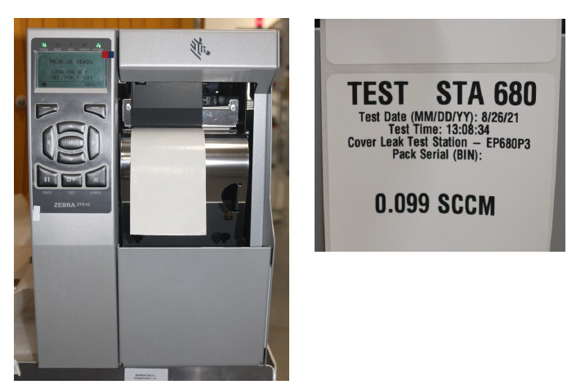
Label Printer

Slide 37
Electrical and Coolant Leak
Test Station EP280 and EP580
Equipment

Slide 38
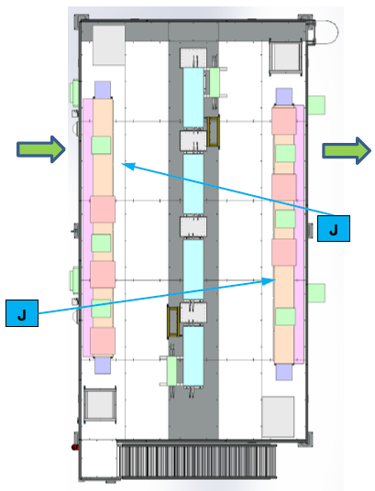
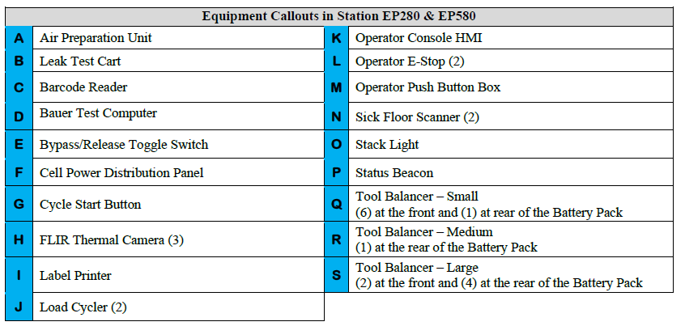
Cell EP280 and EP580 – Mezzanine (1 of 3)
TOP VIEW

Slide 39
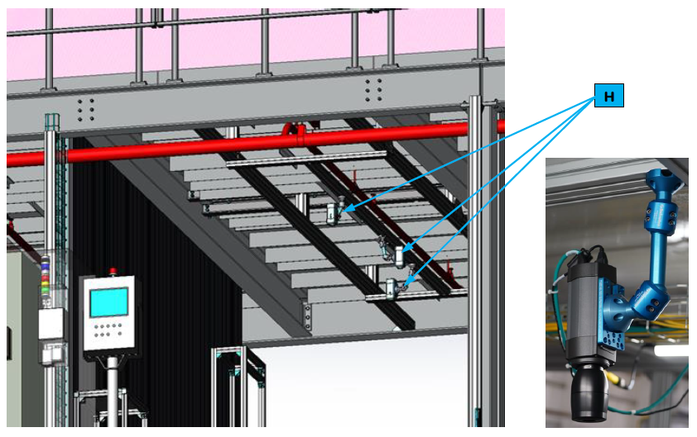
Cell EP280 and EP580 – Mezzanine (2 of 3)
TOP VIEW

Slide 40
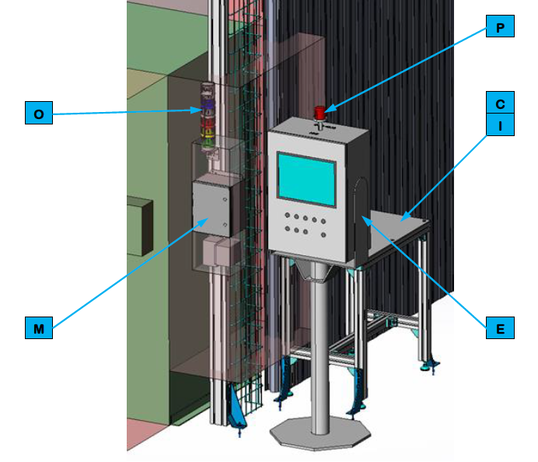
Cell EP280 and EP580 – Mezzanine (3 of 3)
TOP VIEW

Slide 41
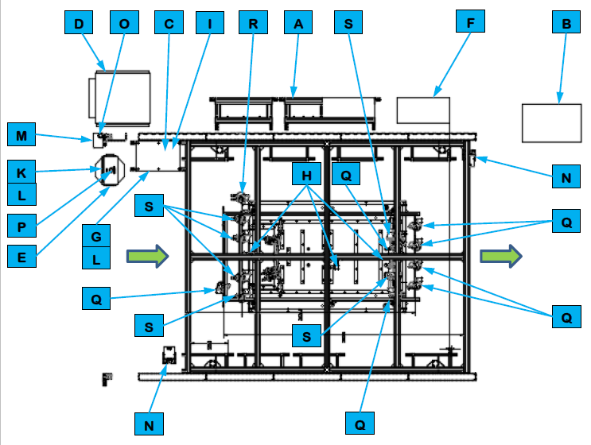
Cell EP280 and EP580 – Under Mezzanine
TOP VIEW

Slide 42
Cell EP280 & EP580
Sequence of Operations

Slide 43
Leak Test Cart
The Leak Test Cart pressurizes the batter pack coolant circuit and determines if it is leak
Tight using a differential pressure decay test method.

Slide 44
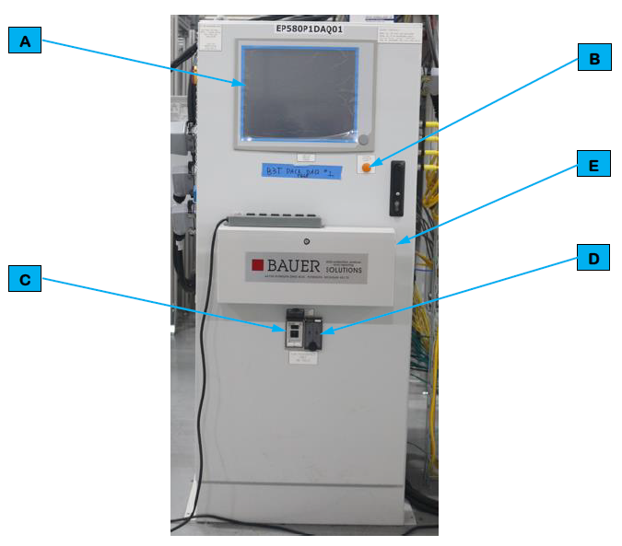
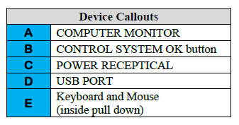
Bauer Test Computer

Slide 45
FLIR Thermal Camera
The FLIR Thermal Cameras detect heat.

Slide 46
Load Cycler
The Cell Load Cycler charges and discharges the Battery Pack for the electrical test
and is controlled by the Baur Test Computer.

Slide 47
Tool Balancer - Small
The Tool Balancer is an adjustable cable system suspended from the cell frame that allows
tools to hang within reach of the Operator.

Slide 48
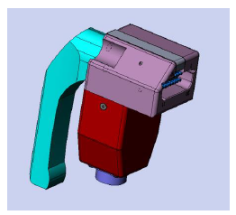
BEV3 X1 LV Connector

Slide 49
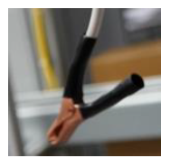
BET / BEV3 Ground Connector 1
BET Ground Connector 2

Slide 50
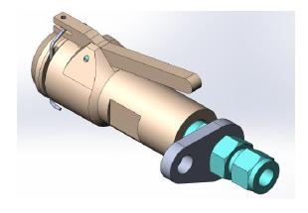
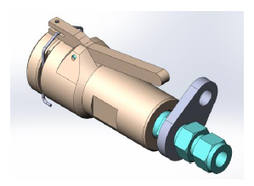
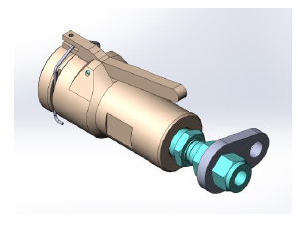
BEV3 Outlet Coolant Connector
BET Outlet / BEV3 Inlet Coolant Connector
BET Inlet Coolant Connector

Slide 51
BET Heater Connector & BET ACEC Connector

Slide 52
Tool Balancer - Medium
The Tool Balancer is an adjustable cable system suspended from the cell frame that allows
tools to hang within reach of the Operator.

Slide 53
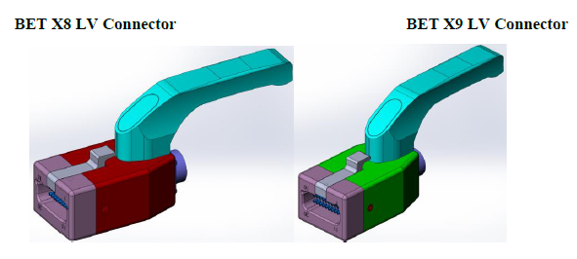
BET X8 LV Connector & BET X9 LV Connector

Slide 54
Tool Balancer - Large
The Tool Balancer is an adjustable cable system suspended from the cell frame that allows
tools to hang within reach of the Operator.

Slide 55
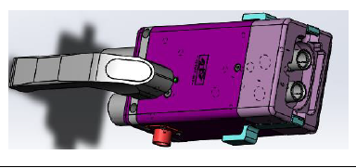
BEV3 DCFC Connector

Slide 56
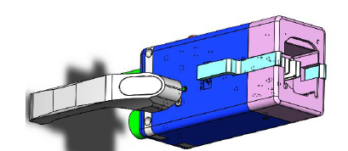
BET FPIM / BEV3 IPE Connector

Slide 57
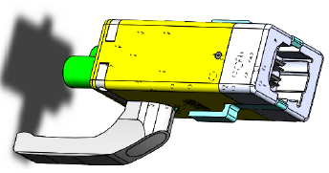
BET LPIM Connector

Slide 58
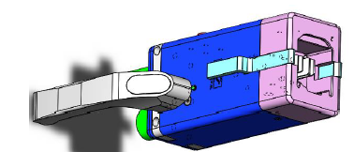
BET RPIM Connector

Slide 59
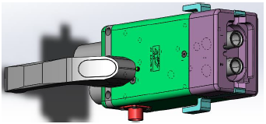
BET DCFC Connector

Slide 60
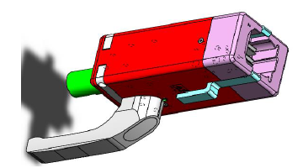
BET IPE / BEV3 RDU Connector

Slide 61
Cover Leak Test Station
EP680 Equipment

Slide 62
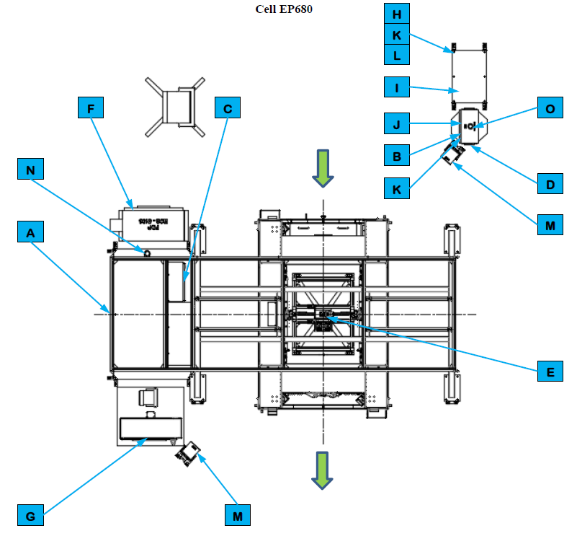
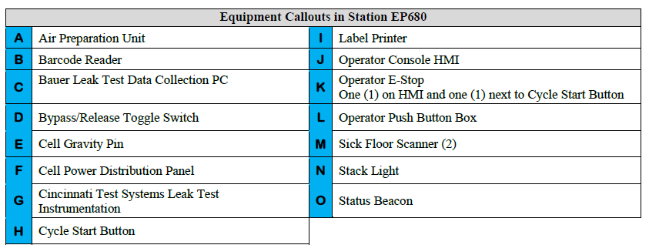
Cell EP680 (1 of 2)

Slide 63
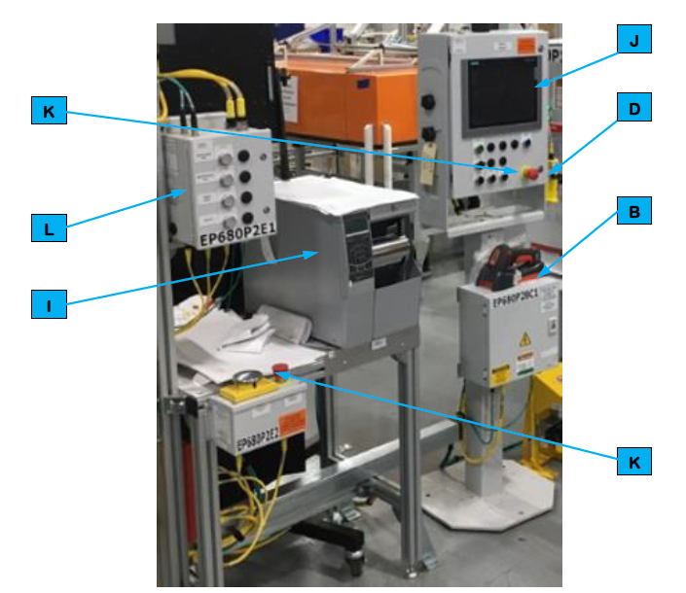
Cell EP680 (2 of 2)

Slide 64
Cell EP680
Sequence of Operations

Slide 65
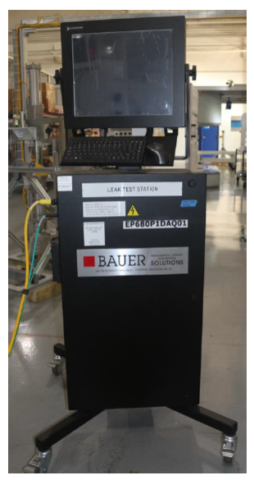
EP680 Bauer Leak Test Data Collection PC

Slide 66
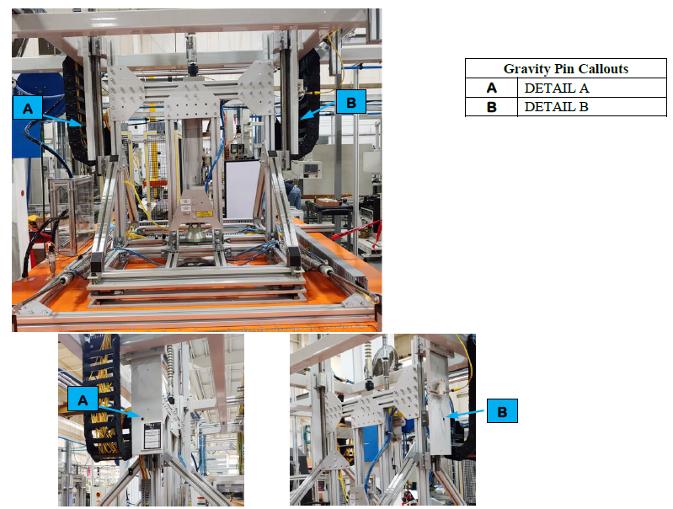
Cell Gravity Pin

Slide 67
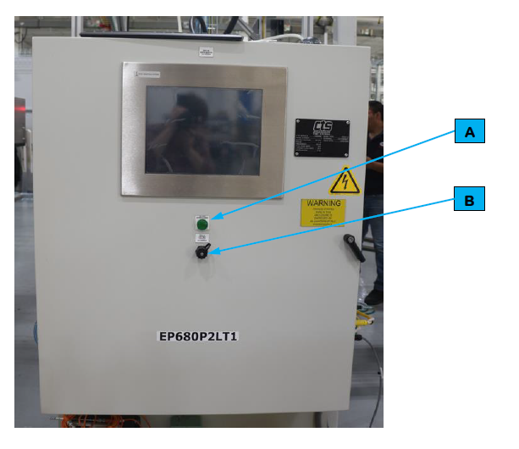
Cincinnati Test Systems Leak Test Instrumentation

Slide 68
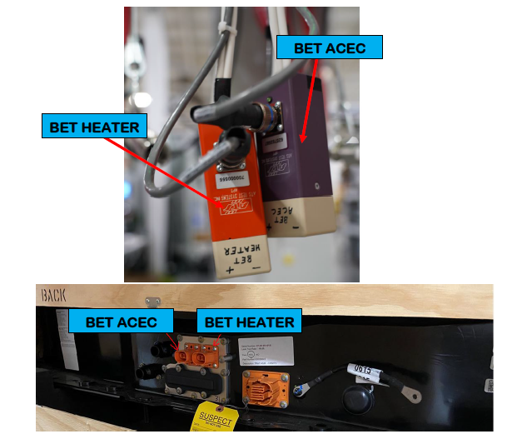
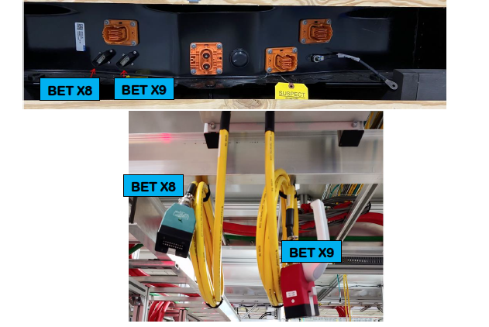
BET Heater & ACEC Header Plug

Slide 69
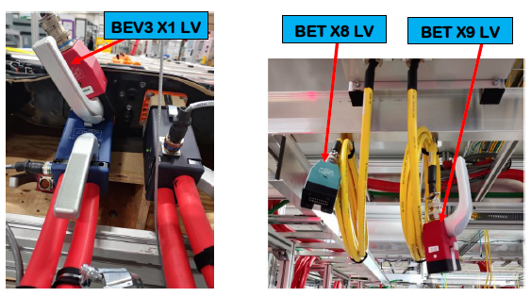
BET / BEV LV Header Plug

Slide 70
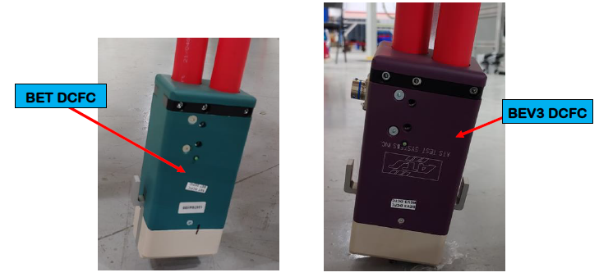
BET / BEV DCFC Header Plug

Slide 71
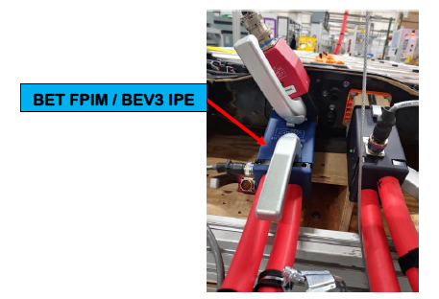
BET / BEV HV Header Plug

Slide 72
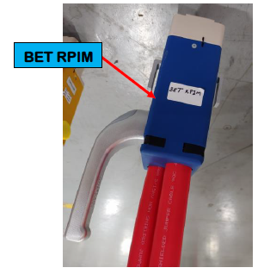
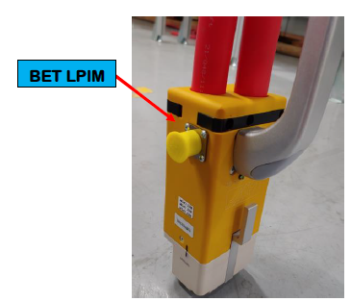
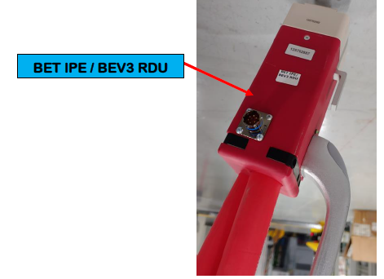
BET / BEV HV Header Plug

Slide 73
Hood Assembly

Slide 74
BET Vacuum Connector

Slide 75
BEV3 Vacuum Connector

Slide 76
Unico Drive Removal Cart

Slide 77
Cover Leak Solenoid Valve

Slide 78
Operating
Instructions

Slide 79
Operator Interface Devices

Slide 80
Interface Device Table – Manual Stations

Slide 81
Barcode Reader

Slide 82
Bypass/Release Toggle Switch

Slide 83
Cycle Start Button

Slide 84
Label Printer

Slide 85
Controls and Indicators

Slide 86
Operator Console Human Machine Interface (HMI)

Slide 87
Operator Emergency Stop (E-Stop)

Slide 88
Operator Push Button Box
Button | Description
RESPONDER CALL | Call a Team Lead.
MAINTENANCE CALL | Call Maintenance Personnel.
PRINT LABEL | Reprint a label if the original printed label is damaged.
RETEST | NOT USED.

Slide 89
Cell Power Distribution Panel

Slide 90
SICK Safety Laser Scanner

Slide 91
Stack Light
Indicator | Action | Description
Horn | Multiple Beeps | Notification Alert
Horn | One Beep | Scan Passed
Blue | Flashing | Operator Load Prompt
Blue | Fast Flashing | N/A
Blue | Solid | In Cycle
White | Flashing | Flexnet Gate Check Query in Progress
White | Fast Flashing | Flexnet Gate Check Failed
White | Solid | Flexnet Gate Check Passed
Red | Flashing | N/A
Red | Fast Flashing | Maintenance Call
Red | Solid | Station Faulted
Yellow | Flashing | Over Cycle
Yellow | Fast Flashing | Responder Call
Yellow | Solid | Approaching End of Cycle
Green | Flashing | Ready for Cycle
Green | Fast Flashing | N/A
Green | Solid | Process Complete

Slide 92
Status Beacon
Indicator | Action | Description
Red | Flashing | Maintenance (High Priority Fault) Alarm Present
Red | Solid | Non-Maintenance (Low Priority Fault) Alarm Present

Slide 93
EP680 Bauer Leak Test Data Collection PC

Slide 94
Cincinnati Test Systems Leak Test Instrumentation

Slide 95
HMI Screens

Slide 96
HMI Screen Navigation Paths

Slide 97
Screen Header

Slide 98
Select Screen

Slide 99
Mode Screen

Slide 100
Scroll List Screen

Slide 101
DAQ Interlock Screen

Slide 102
Station Overview Screen

Slide 103
Cell Overview Screen

Slide 104
Cell Power and I/O Screen

Slide 105
Barcode Screen

Slide 106
EtherNet Public Screen

Slide 107
Switch Ports and Devices Screen

Slide 108
Switch Status Screen

Slide 109
EtherNet Private Screen

Slide 110
Linear Network Screen

Slide 111
Device Details Screen

Slide 112
Alarm Screen

Slide 113
Maintenance History Screen

Slide 114
Cycle Time Screen

Slide 115
Station Throughput Screen

Slide 116
Configuration Screen

Slide 117
Signature Screen

Slide 118
Style Overview Screen

Slide 119
Style Overview Edit Data Screen

Slide 120
Quality Screen

Slide 121
Common Operating Procedures

Slide 122
Starting Cell in Manual Mode

Slide 123
Starting Cell in Automatic Mode

Slide 124
Shutting Down

Slide 125
Recovering from an Emergency Stop

Slide 126
Recovering from a Fault

Slide 127
Mastering Sequence for Pack Coolant Leak Test

Slide 128
Mastering Sequence for Pack Cover Leak Test

Slide 129
Auto Mode

Slide 130
Manual Mode

Slide 131
Questions & Answers

Slide 132
Mechanical Drawings
Overview

Slide 133
TIS and TIV
Overview

Slide 134
Questions & Answers

Slide 135
TIS and TIV Overview
(At the Machine)

Slide 136
Questions & Answers

Slide 137
Troubleshooting
and Faults
(At the Machine)

Slide 138
Questions & Answers

Slide 139
Class Wrap-Up
Closing Remarks
Complete Task Certifications
Complete Course Evaluations

