Slide 1
Pack Line
Operator Training Course
4 Hour Course – ½ Day

Slide 2
Introductions
Instructor: Bill Flatley

Slide 3
Safety Test and Review

Slide 4
System Safety
(At the Machine)

Slide 5
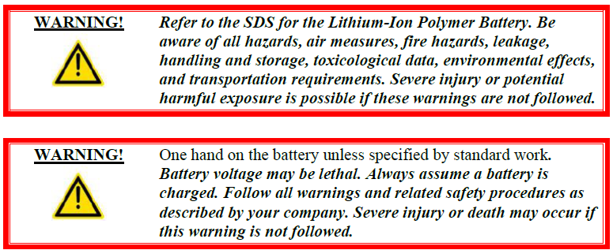
Battery Safety Overview
Assembly line personnel must comply with all safety rules.

Slide 6
Health & Safety
Statement

Slide 7
General Safety Guidelines
Read the Entire Manual
Good Work Habits
Consider Personal Health
Dress Properly
Clean and Safe Work Area
Safety Signage
ECPL Placard Locations
Use Tools Properly
Electrical System Safety
Mechanical System Safety
Operating Safety Precautions
Safety Devices

Slide 8
Personal Safety
Accidents often do not occur as the result of a single cause, but may occur because of an
interaction between working conditions, human error, and other events.
Knowledge First
Work Habits
Fitness for Duty
Dressing for Safety
Eye Protection
Hearing Protection
Head Protection
Foot Protection

Slide 9
Work Area Safety
Cleanliness
Warning Signs
Traffic Areas
Unsafe Conditions
Cell Guarding
Automated Guide Cart (AGC) Safety
Lift Assist Safety
Working at Heights Safety

Slide 10
ECPL Placards & Tags
Energy Control and Power Lockout

Slide 11
Tool Usage

Slide 12
Machine Safety
Electrical Safety
Pneumatic Safety
Mechanical Safety

Slide 13
Safety Device
Locations

Slide 14
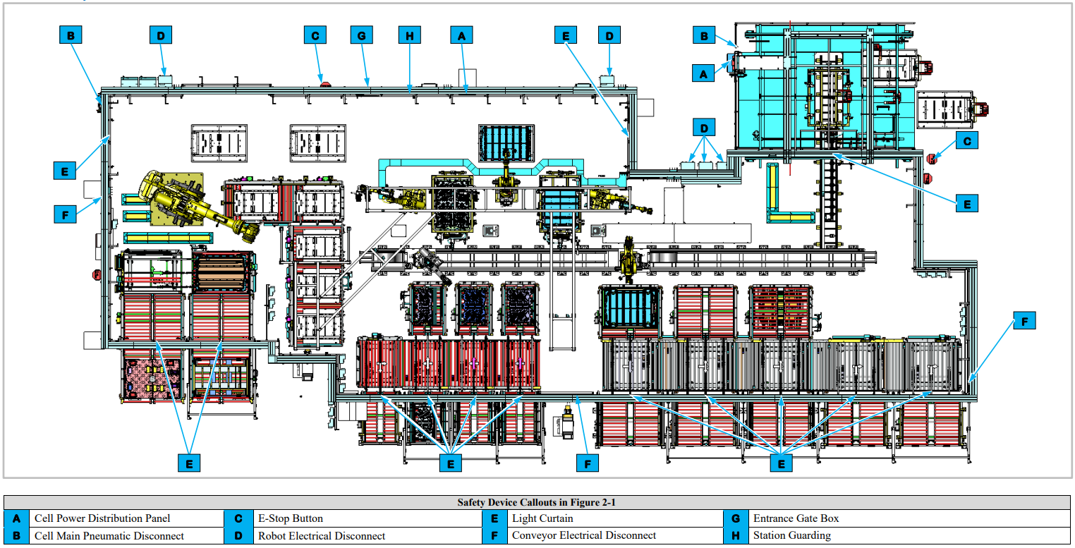
Safety Device Locations
for Cell EP020 and EP720

Slide 15
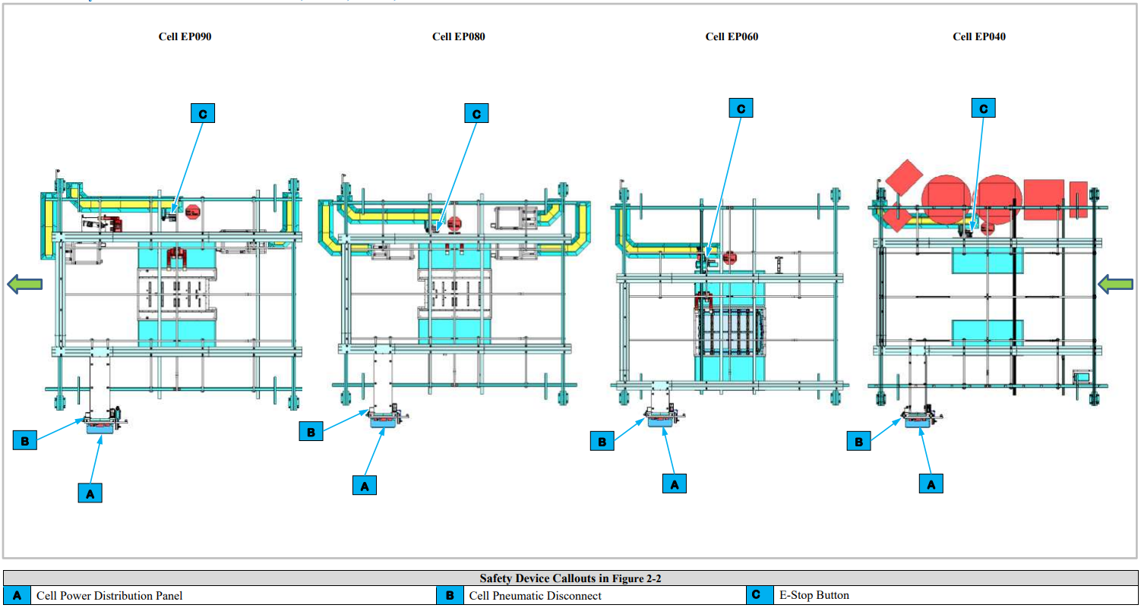
Safety Device Locations
for Cell EP040, EP060, EP080 and EP090

Slide 16
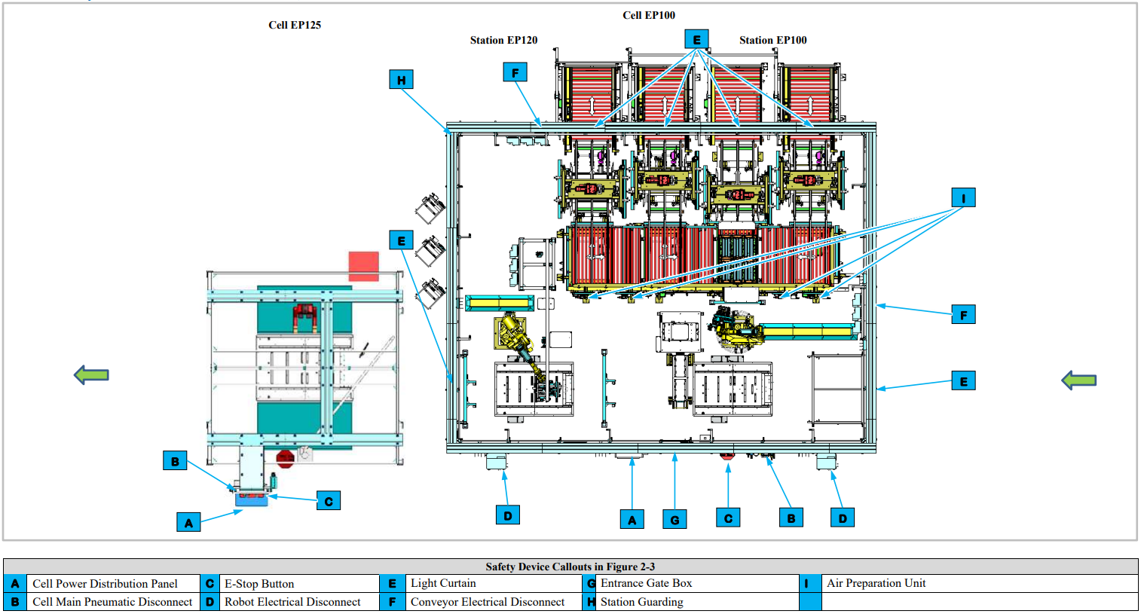
Safety Device Locations
for Cell EP100 and EP125

Slide 17
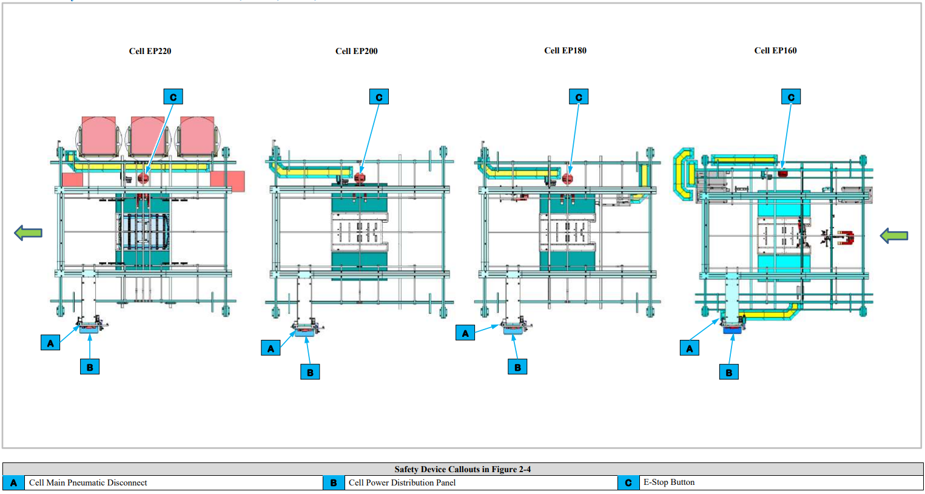
Safety Device Locations
for Cell EP160, EP180, EP200 and EP220

Slide 18
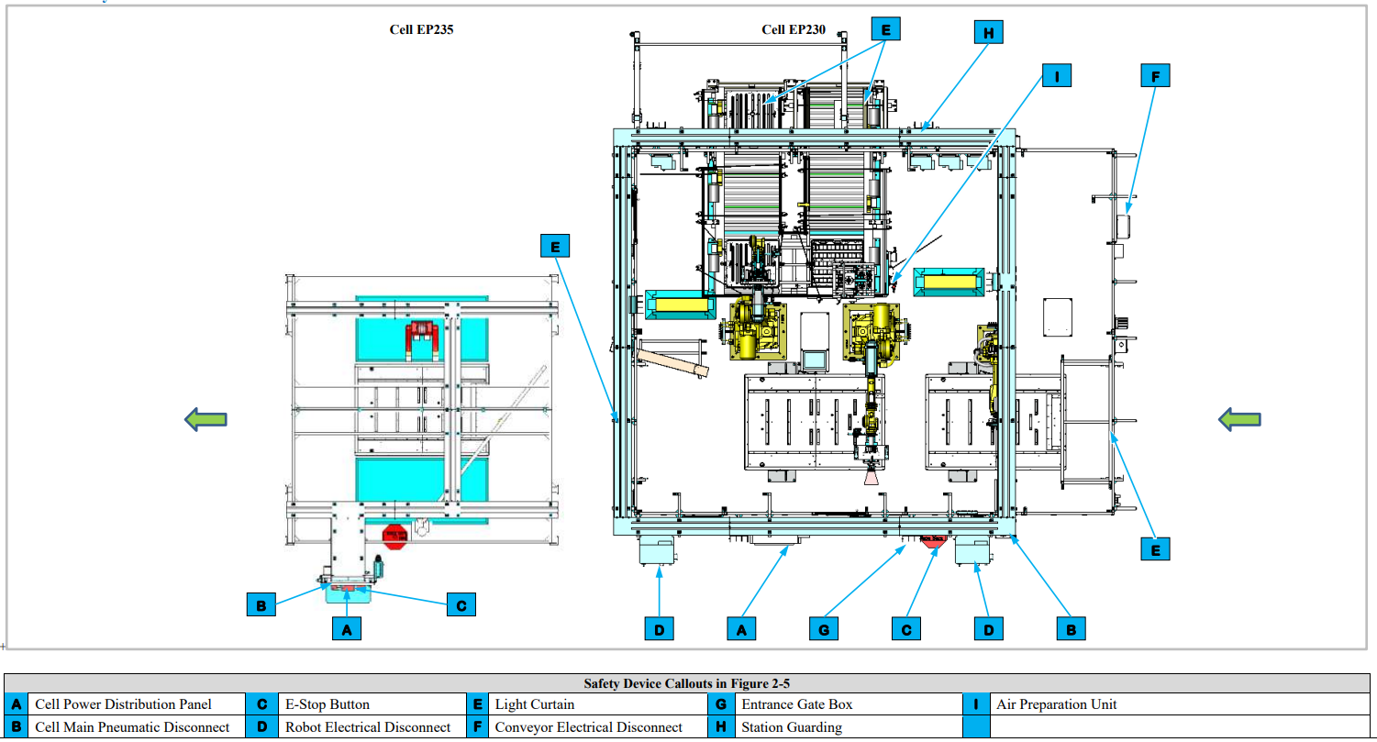
Safety Device Locations
for Cell EP230 and EP235

Slide 19
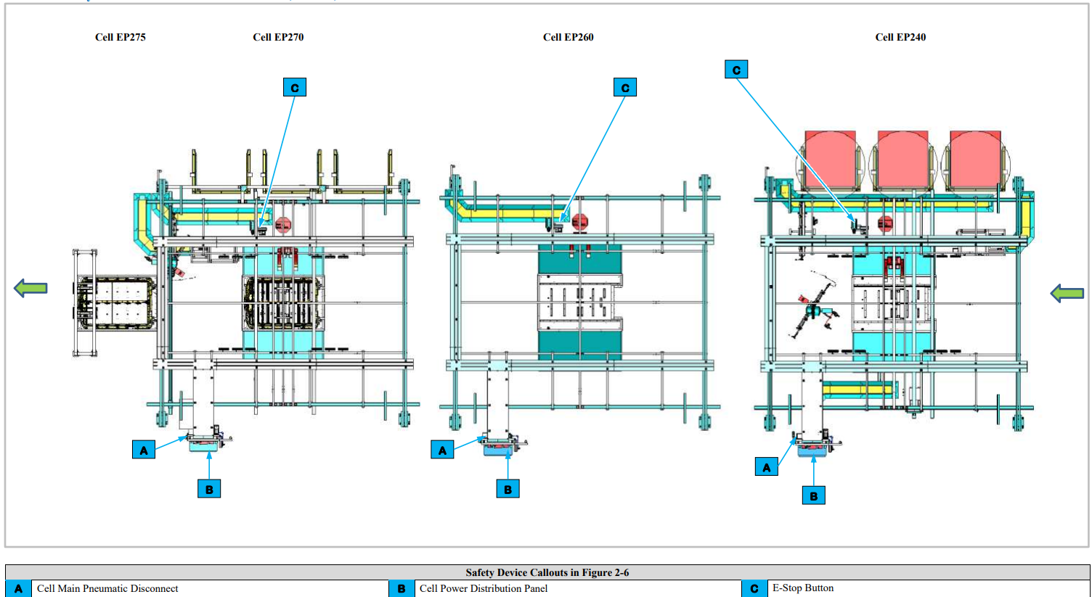
Safety Device Locations
for Cell EP240, EP260 and EP270

Slide 20
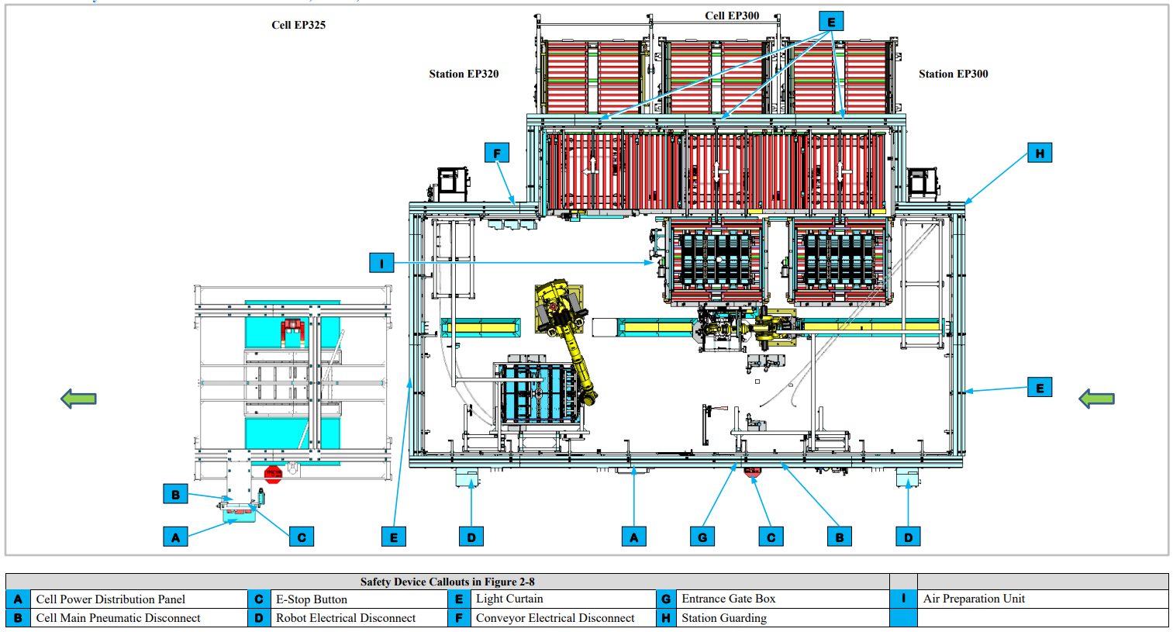
Safety Device Locations
for Cell EP300, EP320 and EP325

Slide 21
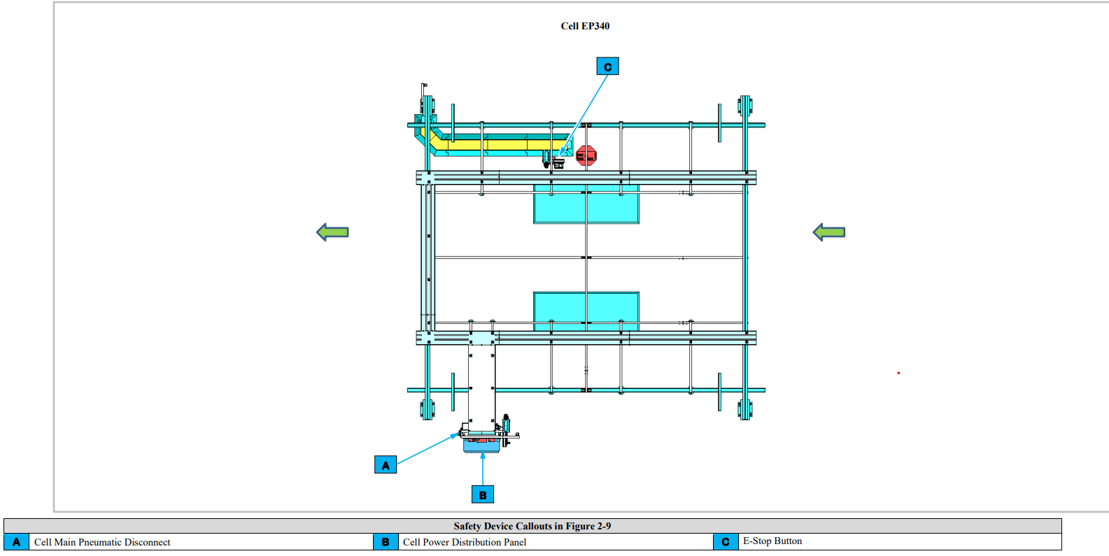
Safety Device Locations
for Cell EP340

Slide 22
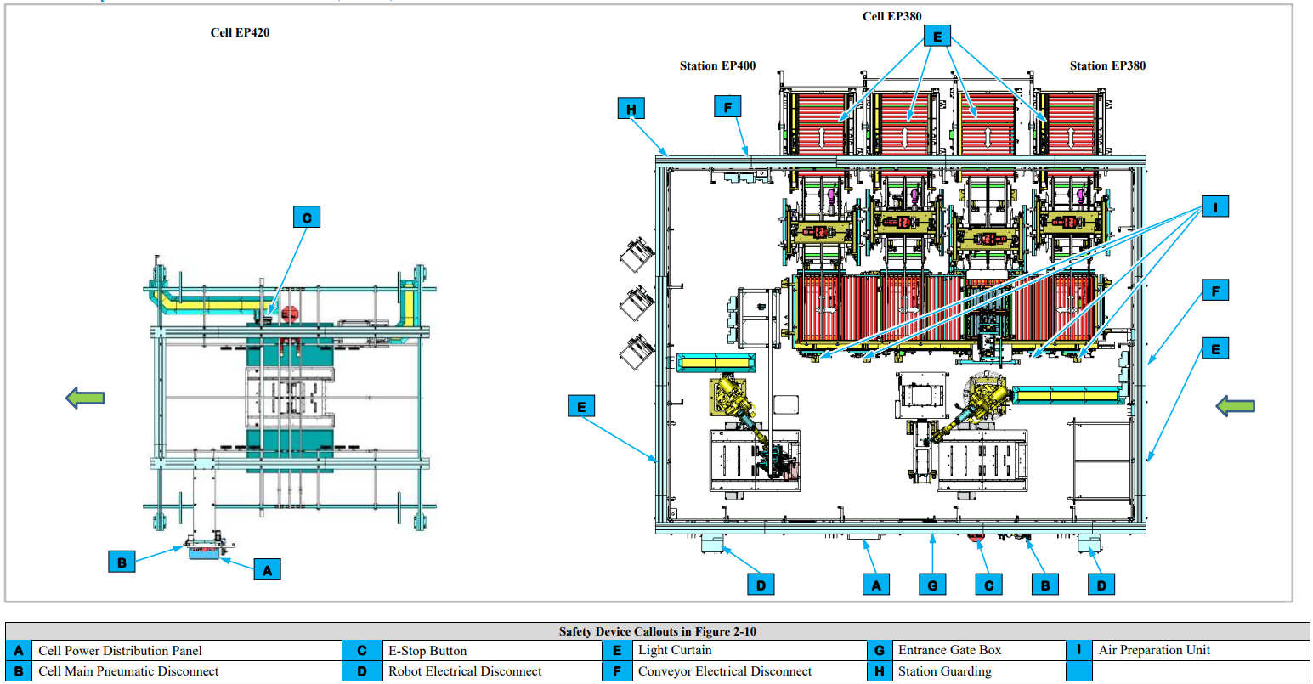
Safety Device Locations
for Cell EP380, EP400 and EP420

Slide 23
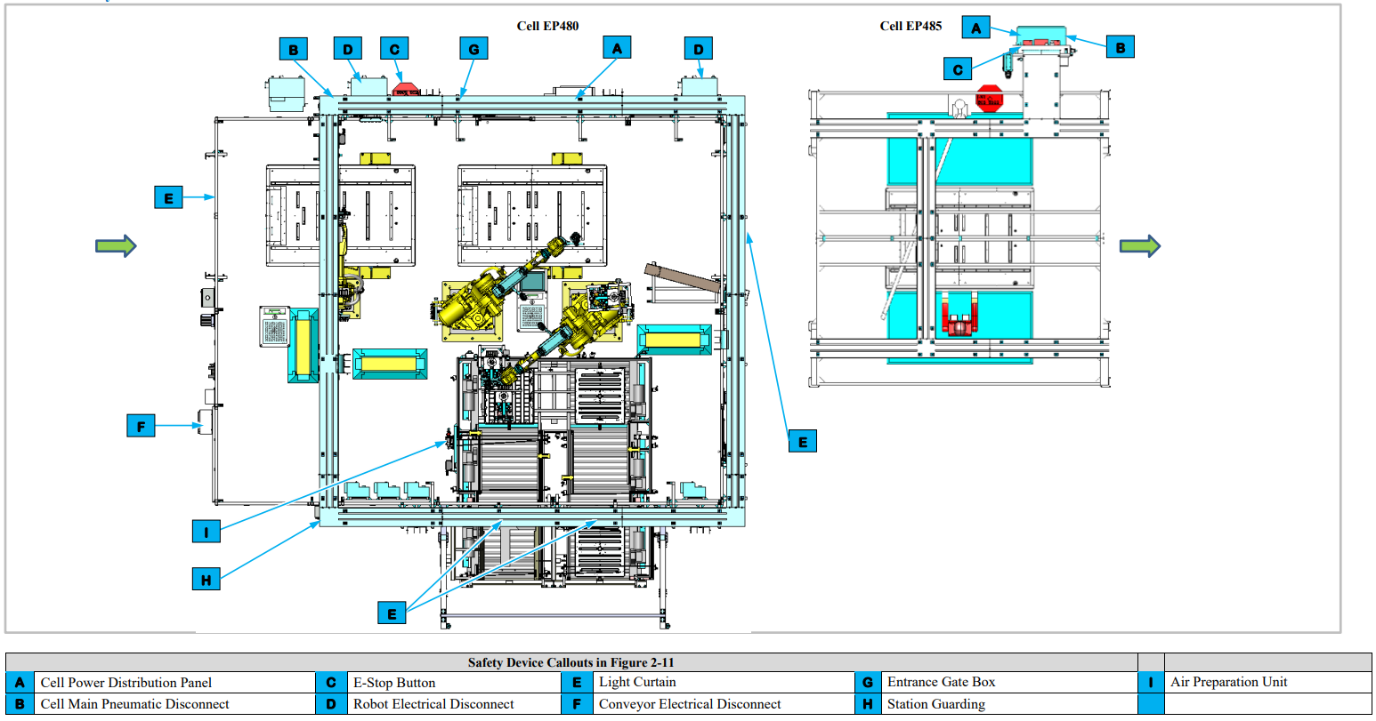
Safety Device Locations
for Cell EP480 and EP485

Slide 24
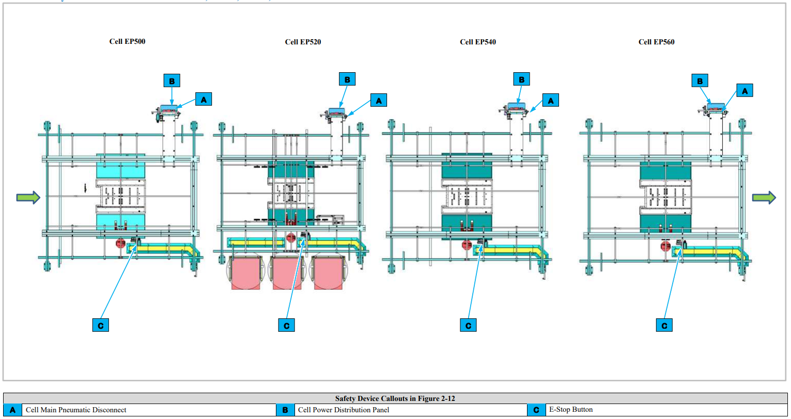
Safety Device Locations
for Cell EP500, EP520, EP540 and EP560

Slide 25
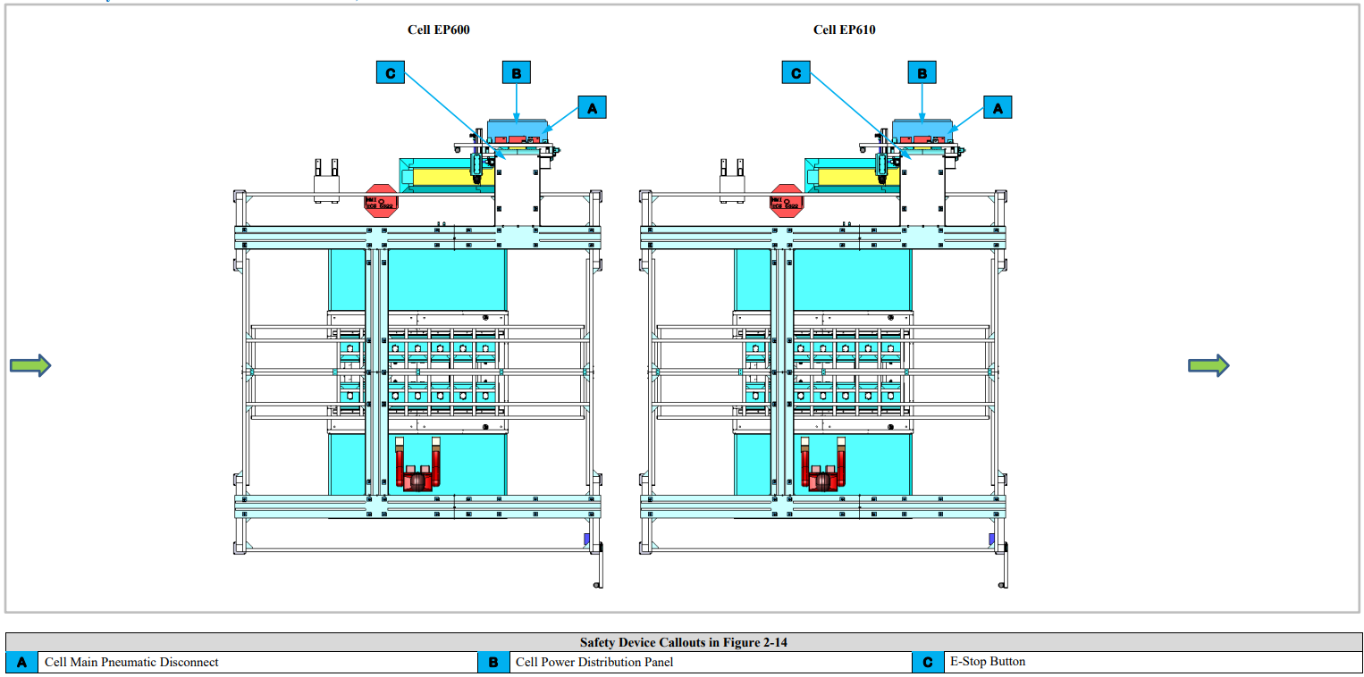
Safety Device Locations
for Cell EP600 and EP610

Slide 26
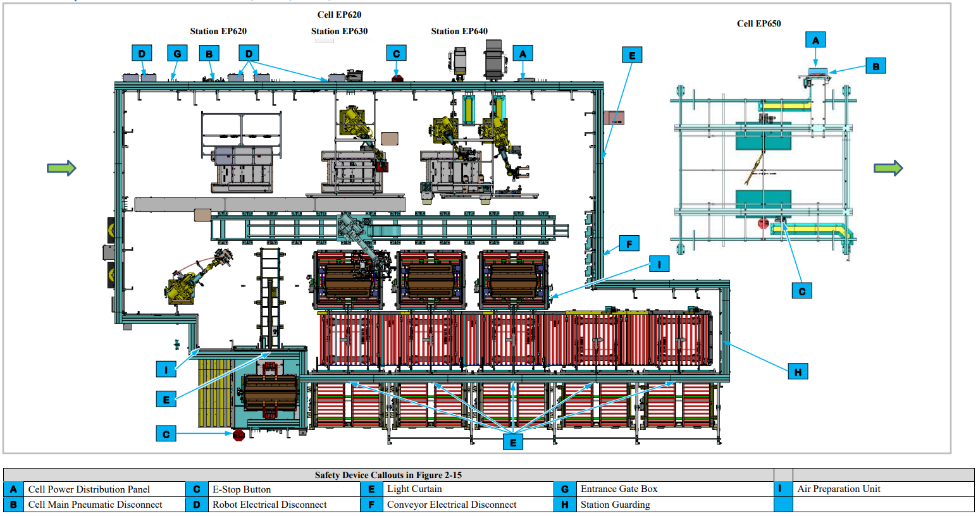
Safety Device Locations
for Cell EP620, EP630, EP640 and EP650

Slide 27
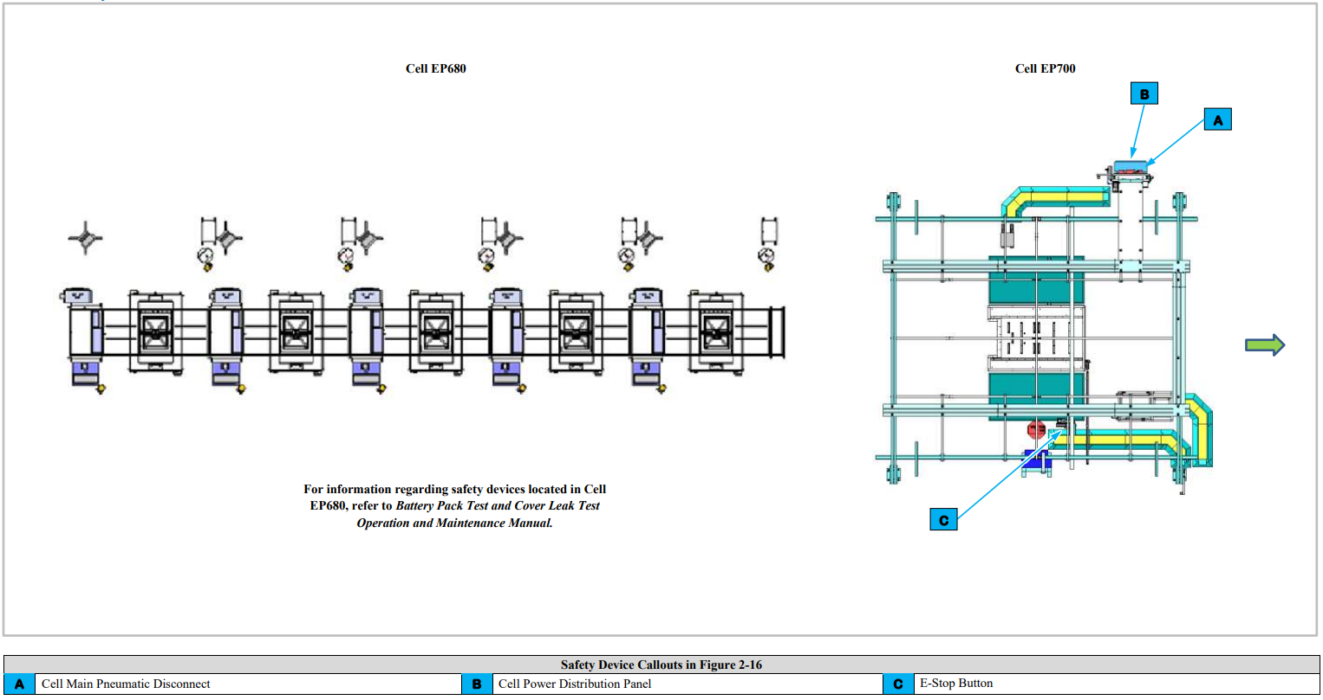
Safety Device Locations
for Cell EP680 and EP700

Slide 28
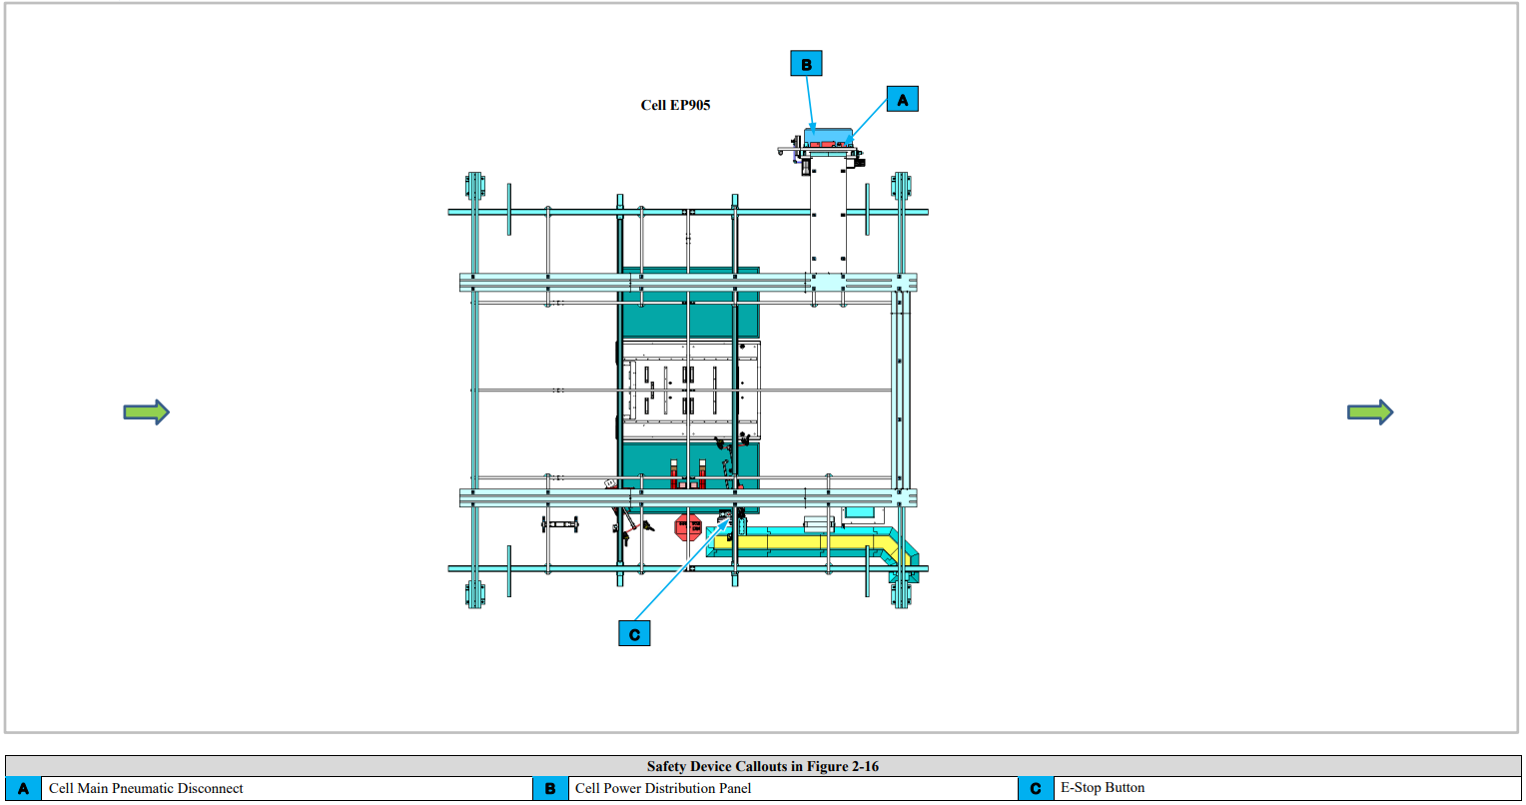
Safety Device Locations
for Cell EP905

Slide 29
Safety Device Locations
for Cell EP020 and EP720

Slide 30
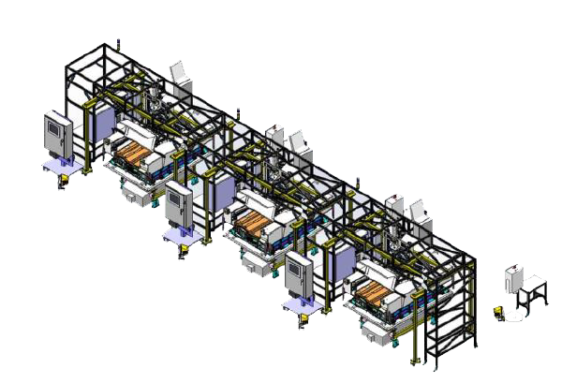
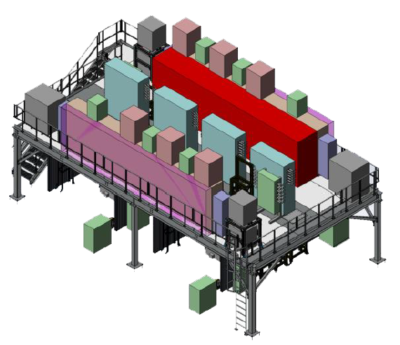
Energy Control Devices

Slide 31
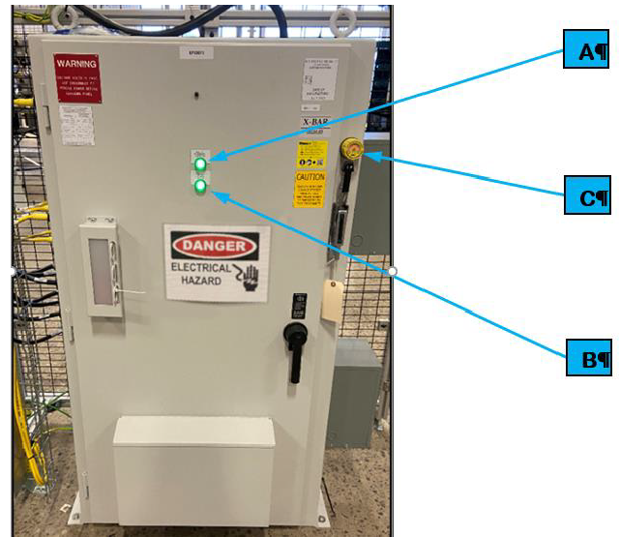
Cell Power Distribution Panel

Slide 32
Cell Main Pneumatic Disconnect
Each cell requires compressed air and has its own air processing equipment that
processes air supplied from the plant and distributes the processed air to the cell
equipment.

Slide 33
SDS References

Slide 34
Break

Slide 35
System
Description Overview
(At the Machine)

Slide 36
BET/BEV3 Pack Main LineSummary
The BET/BEV3 Pack Main Line is part of a larger BET/BEV3 Battery Pack Assembly System.

Slide 37
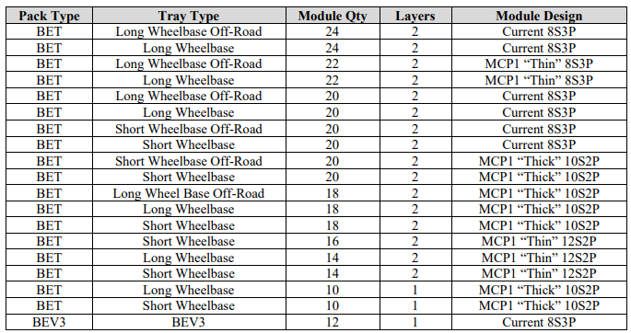
The following lists the 19 battery assembly types handled by the Battery Pack Tests and
Cover Leak Test.

Slide 38
BET/BEV2 Battery Pack
Assembly System Layouts

Slide 39
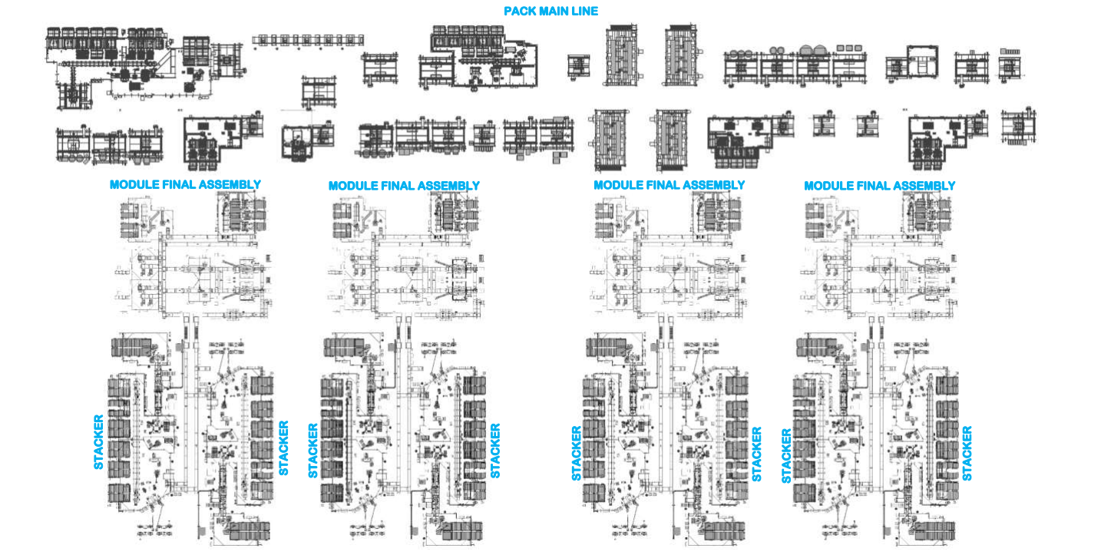
Battery Pack Test System Layout

Slide 40
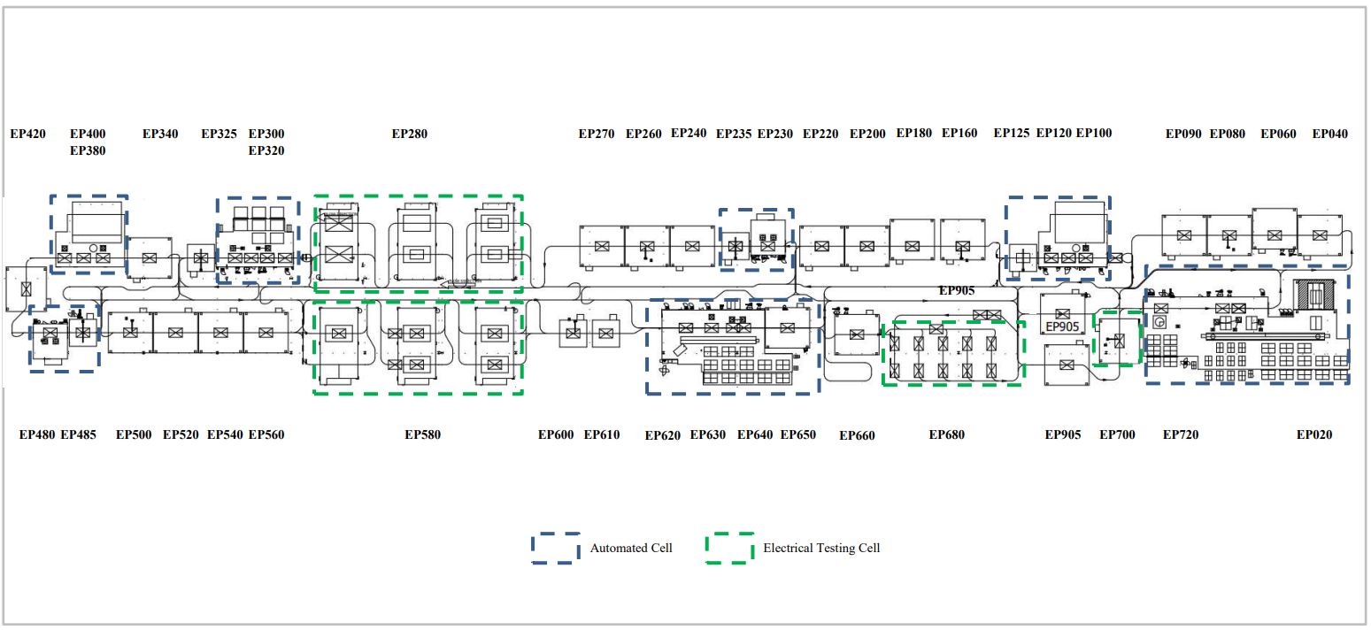
Cover Leak Test System Layout

Slide 41
BET/BEV2 Battery Pack Test
and Cover Leak Test
Utilities

Slide 42
Battery Pack Test and
Cover Leak Test Utilities – Automated Stations

Slide 43
Battery Pack Test and
Cover Leak Test Utilities – Manual Stations

Slide 44
BET/BEV2 Battery Pack Test
and Cover Leak Test
Equipment

Slide 45
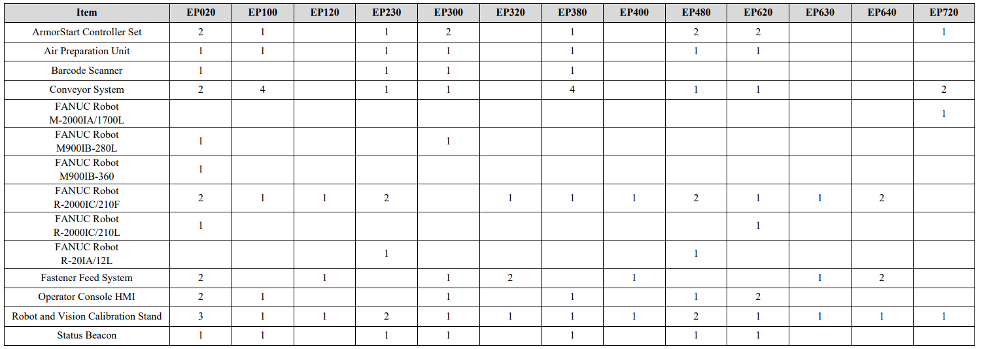
Equipment Matrix – Automated Stations

Slide 46
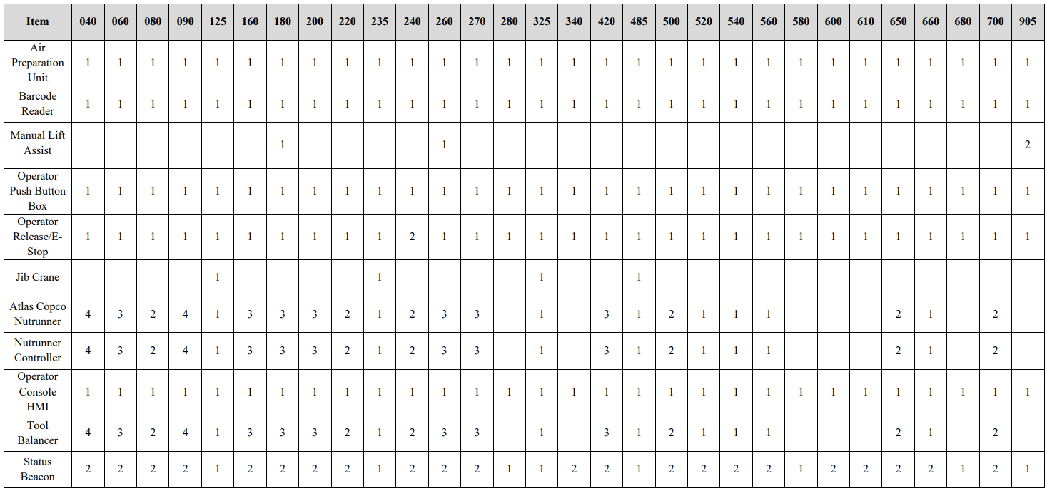
Equipment Matrix – Manual Stations

Slide 47
Station Descriptions and Sequence of Operations

Slide 48
Common Equipment

Slide 49
Common Equipment

Slide 50
Air Preparation Unit

Slide 51
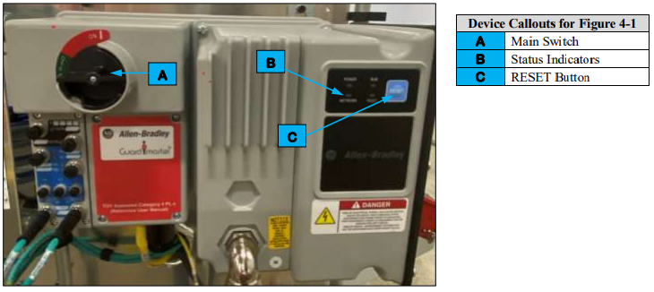
ArmorStart Controller

Slide 52
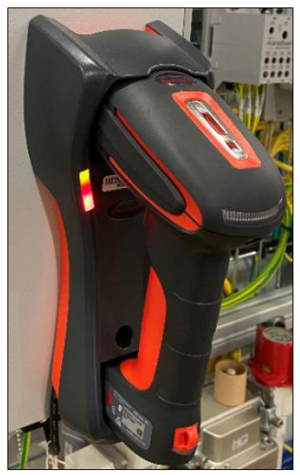
Barcode Reader

Slide 53
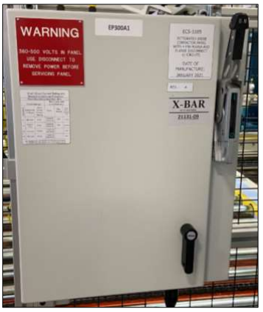
Conveyor Electrical Disconnect

Slide 54
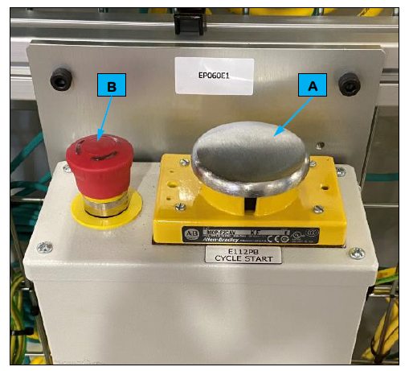
Cycle Start Button

Slide 55
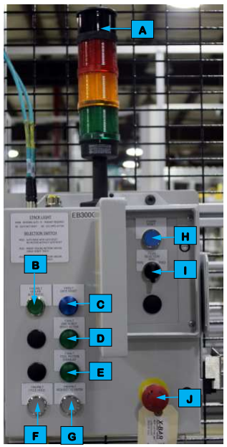
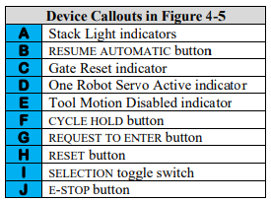
Entrance Gate Box

Slide 56
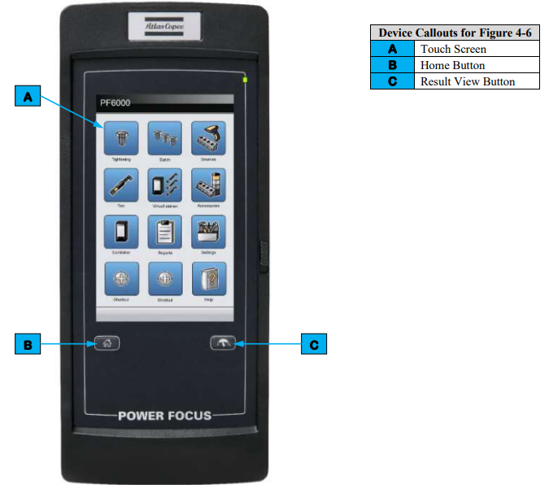
Nutrunner Controller

Slide 57
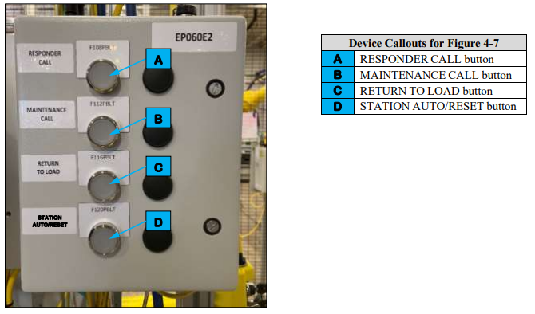
Operator Push Button Box

Slide 58
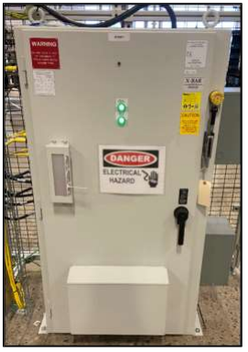
Power Distribution Panel

Slide 59
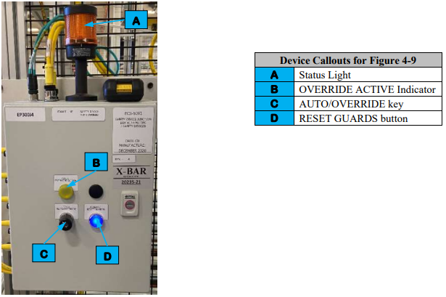
Safety Device Junction Box

Slide 60
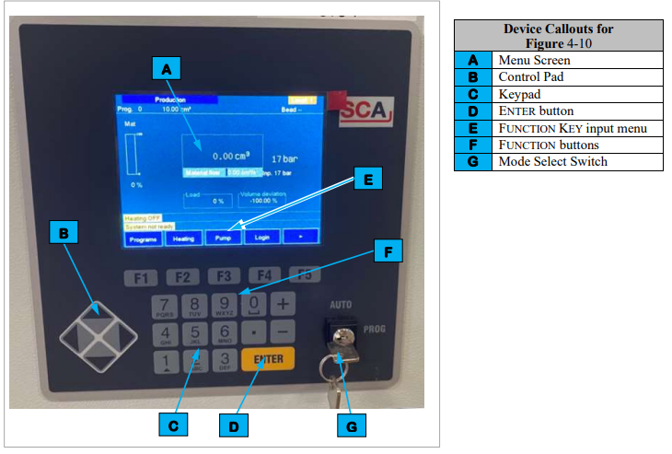
RTV Dispense System Controller

Slide 61
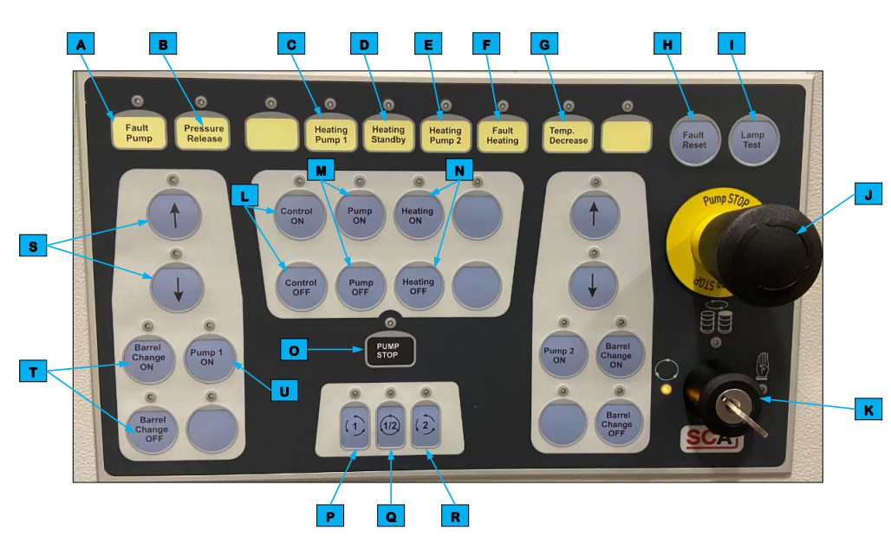
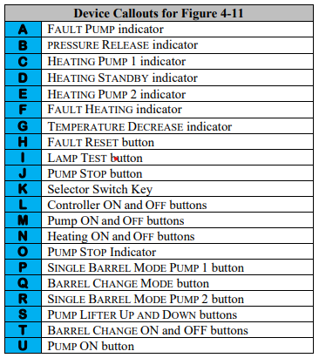
RTV Dispense Pump Control Panel

Slide 62
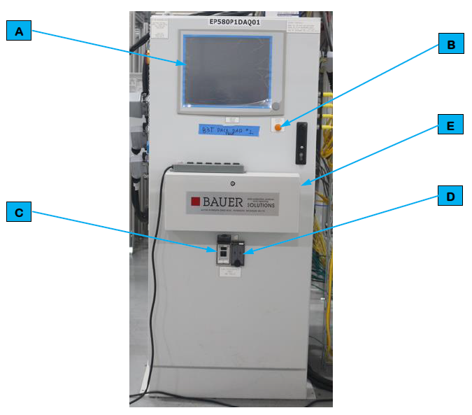
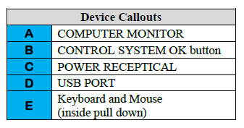
Bauer Test Computer

Slide 63
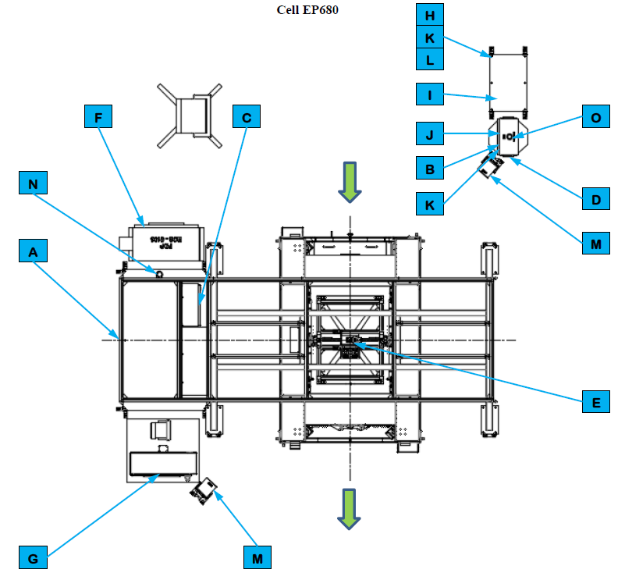
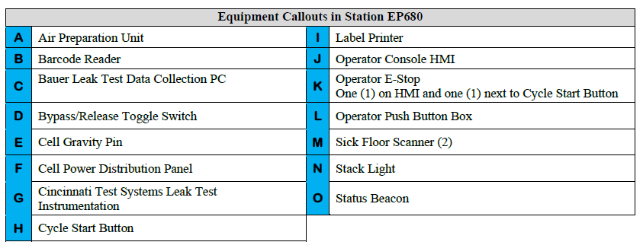
Cell EP680 (1 of 2)

Slide 64
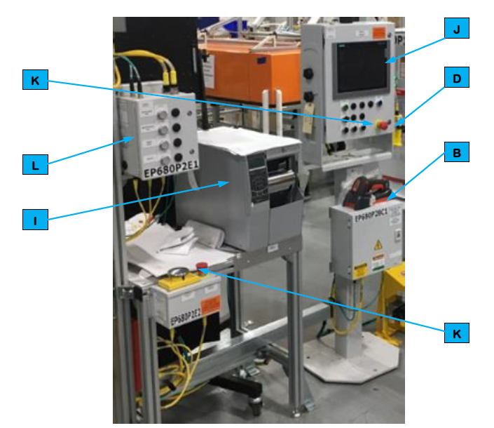
Cell EP680 (2 of 2)

Slide 65
Operator Interface Devices

Slide 66
Controls and Indicators

Slide 67
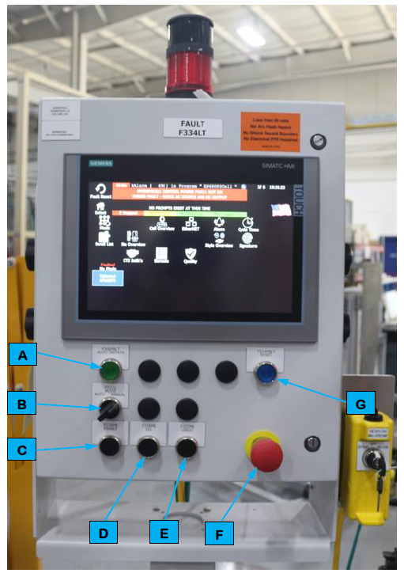
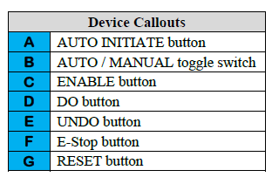
Operator Console Human Machine Interface (HMI)

Slide 68
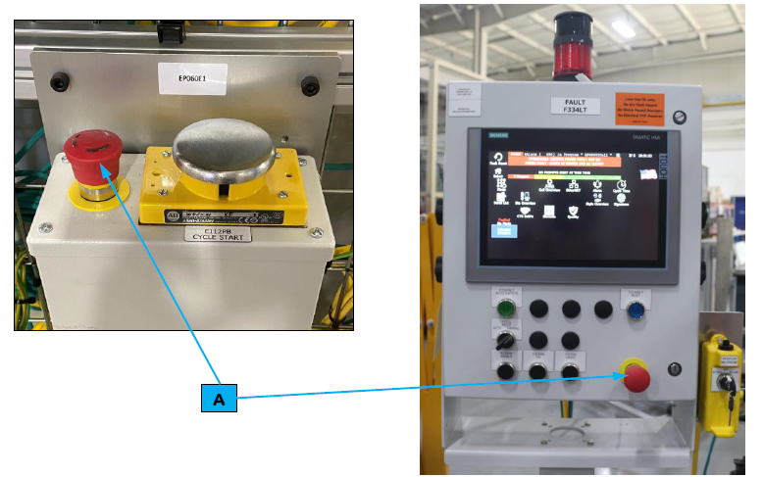
Operator Emergency Stop (E-Stop)

Slide 69
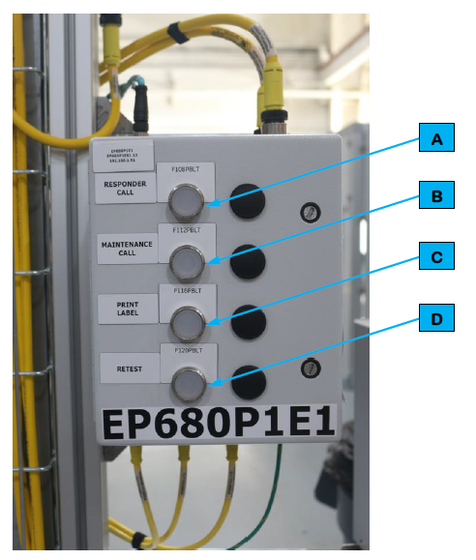
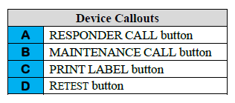
Operator Push Button Box
Button | Description
RESPONDER CALL | Call a Team Lead.
MAINTENANCE CALL | Call Maintenance Personnel.
PRINT LABEL | Reprint a label if the original printed label is damaged.
RETEST | NOT USED.

Slide 70
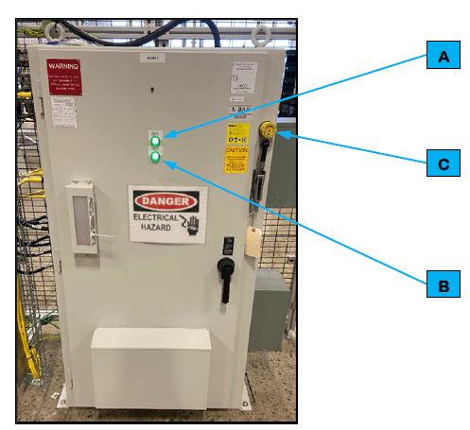
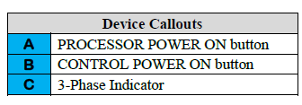
Cell Power Distribution Panel

Slide 71
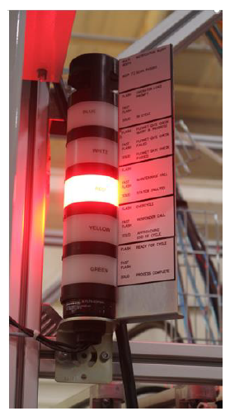
Stack Light
Indicator | Action | Description
Horn | Multiple Beeps | Notification Alert
Horn | One Beep | Scan Passed
Blue | Flashing | Operator Load Prompt
Blue | Fast Flashing | N/A
Blue | Solid | In Cycle
White | Flashing | Flexnet Gate Check Query in Progress
White | Fast Flashing | Flexnet Gate Check Failed
White | Solid | Flexnet Gate Check Passed
Red | Flashing | N/A
Red | Fast Flashing | Maintenance Call
Red | Solid | Station Faulted
Yellow | Flashing | Over Cycle
Yellow | Fast Flashing | Responder Call
Yellow | Solid | Approaching End of Cycle
Green | Flashing | Ready for Cycle
Green | Fast Flashing | N/A
Green | Solid | Process Complete

Slide 72
Status Beacon
Indicator | Action | Description
Red | Flashing | Maintenance (High Priority Fault) Alarm Present
Red | Solid | Non-Maintenance (Low Priority Fault) Alarm Present

Slide 73
HMI Screens

Slide 74
HMI Screen Navigation Paths

Slide 75
Screen Header

Slide 76
Select Screen

Slide 77
Mode Screen

Slide 78
Service Screen

Slide 79
Cell Overview Screen

Slide 80
Cell Power and I/O Screen

Slide 81
EtherNet Screen

Slide 82
Alarm Screen

Slide 83
Maintenance History Screen

Slide 84
Throughput Overview Screen

Slide 85
Station Throughput Screen

Slide 86
Scroll List Screen

Slide 87
Station Overview Screen

Slide 88
Robot Screen

Slide 89
Barcode Screen

Slide 90
Printer Screen

Slide 91
Bowl Feeder Screen

Slide 92
Device Diagnostic Screen

Slide 93
Configuration Screen

Slide 94
Operator Function Screen

Slide 95
Signature Screen

Slide 96
Camera Screen

Slide 97
Manual Repair Screen

Slide 98
Part Present Screen

Slide 99
Schedule Screen

Slide 100
Style Overview Screen

Slide 101
Common Operating Procedures

Slide 102
Inspecting the Line
Starting Cell in Manual Mode
Starting an Automated Cell
Stopping a Cycle
Cycle Stop
Emergency Stop

Slide 103
Shutting Down
Recovering from a Fault
Recovering from an Emergency Stop
Recovering from a Fault
Opening and Closing an Entrance Gate

Slide 104
Modes of Operation

Slide 105
Hands On
(At the Machine)

Slide 106
HMI Screens

Slide 107
Common Operating Procedures

Slide 108
Modes of Operation

Slide 109
Manual Station
Operation

Slide 110
Automated Station
Operation – Auto Mode

Slide 111
Automated Station
Operation – Manual Mode

Slide 112
Class Wrap-Up
Closing Remarks
Complete Course Evaluations

