Slide 1


BET/BEV3 Module Final Assembly Line
Mechanical Training Course
4 Hour Course – 1 Day

Slide 2
Introductions
Instructor: Bill Flatley

Slide 3
Safety Test and Review

Slide 4
System Safety
(At the Machine)

Slide 5
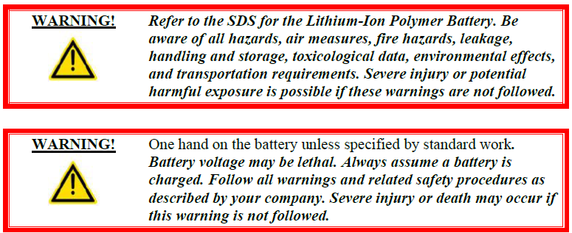
Battery Safety Overview
Assembly line personnel must comply with all safety rules.

Slide 6
Health & Safety
Statement

Slide 7
General Safety Guidelines
Read the Entire Manual
Good Work Habits
Consider Personal Health
Dress Properly
Clean and Safe Work Area
Safety Signage
ECPL Placard Locations
Use Tools Properly
Electrical System Safety
Mechanical System Safety
Operating Safety Precautions
Safety Devices

Slide 8
Personal Safety
Accidents often do not occur as the result of a single cause, but may occur because of an
interaction between working conditions, human error, and other events.
Knowledge First
Work Habits
Fitness for Duty
Dressing for Safety
Eye Protection
Hearing Protection
Head Protection
Foot Protection

Slide 9

Work Area Safety
Cleanliness
Warning Signs
Traffic Areas
Unsafe Conditions
Cell Guarding
Conveyor Safety
Working at Heights Safety

Slide 10
ECPL Placards & Tags
Energy Control and Power Lockout

Slide 11
Tool Usage

Slide 12





Machine Safety
Electrical Safety
Pneumatic Safety
Mechanical Safety

Slide 13
Safety Device
Locations

Slide 14
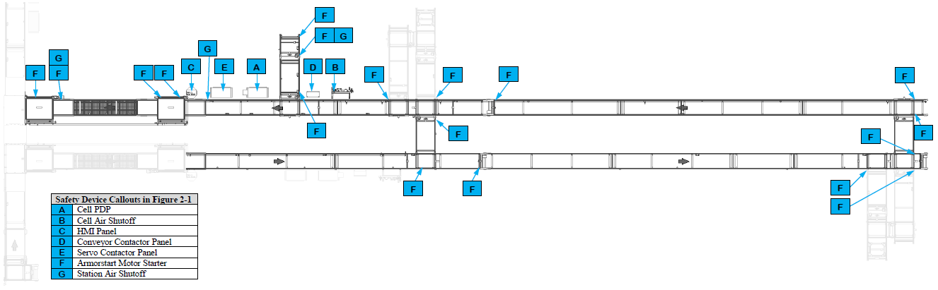
Safety Device Locations
Module Input VTU

Slide 15
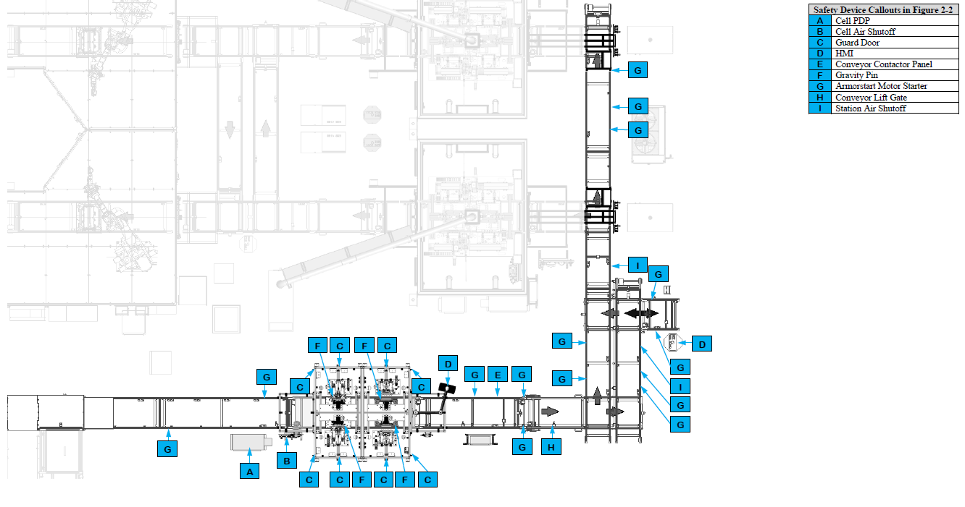
Safety Device Locations
Post Tab Bend

Slide 16
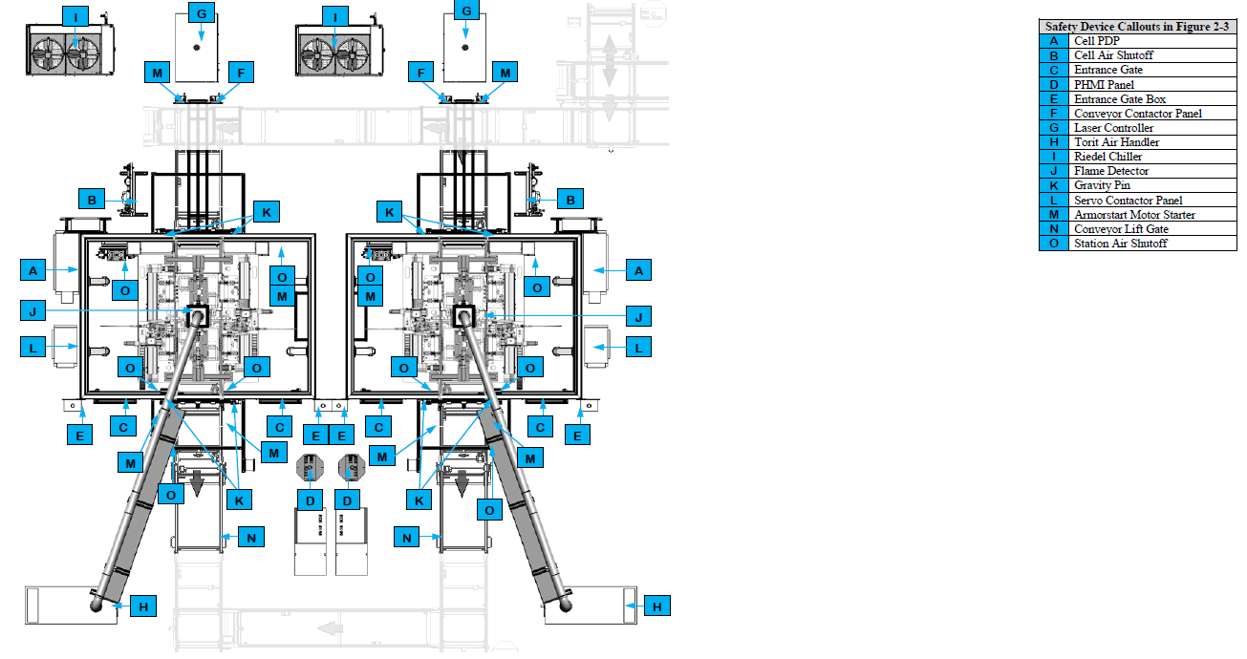
Safety Device Locations
Tab Weld

Slide 17
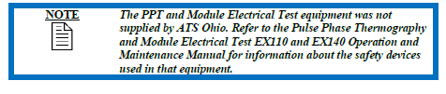
Safety Device Locations
Pulse Phase Thermography / Module Electrical Test

Slide 18
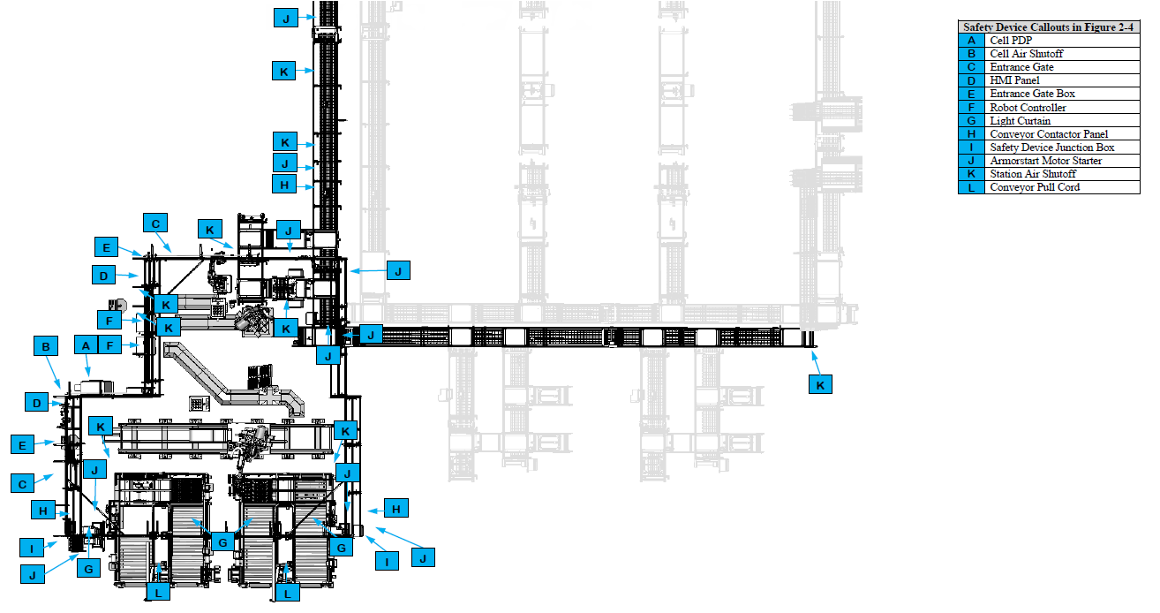
Safety Device Locations
Module Cover Install

Slide 19
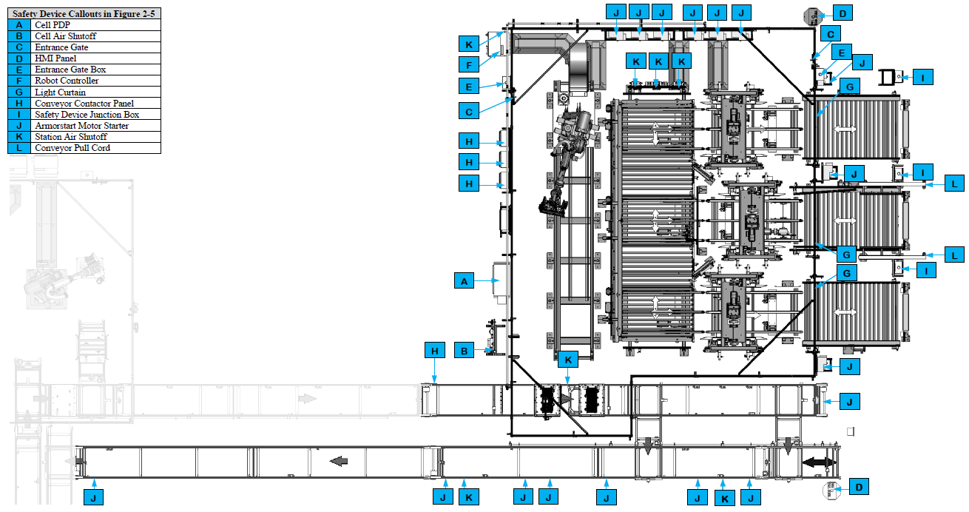
Safety Device Locations
Module Transfer

Slide 20
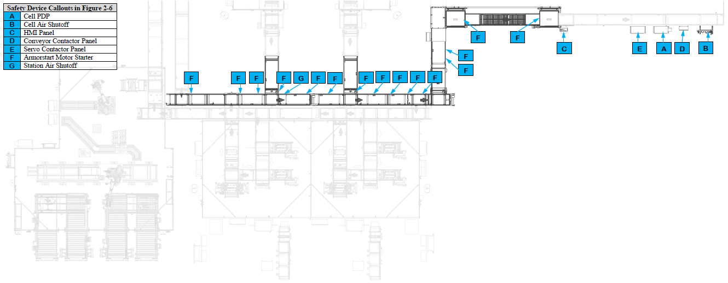
Safety Device Locations
Module Return VTU

Slide 21
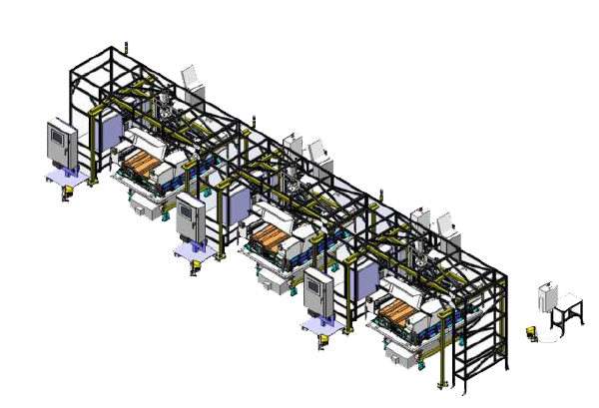
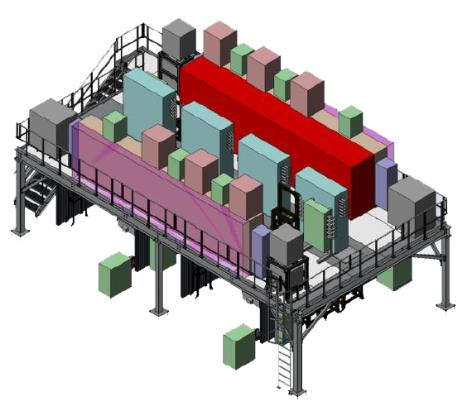
Energy Control Devices

Slide 22
Cell Power Distribution Panel
Cell Main Pneumatic Disconnect
Entrance Gate Door
HMI/PHMI Panels
Entrance Gate Box
Robot Electrical / Pneumatic Disconnect
Light Curtain / Sensing Field
Conveyor Contractor Panel
Safety Device Junction Box
Laser Controller
Torit Air Handler

Slide 23
Riedel Chiller
Flame Detector
Gravity Pins
ArmorStart Motor Starter
Servo Contractor Panel
Conveyor Lift Gate
Station / Device Air Shutoff
Conveyor Pull Cord

Slide 24
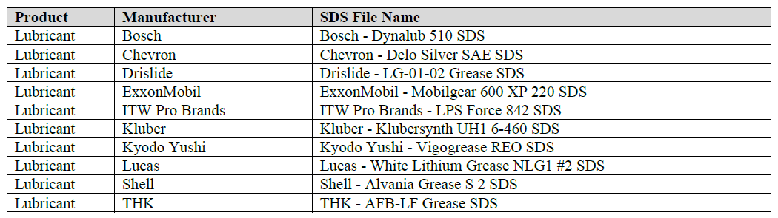
SDS References

Slide 25
Break

Slide 26
System
Description Overview
(At the Machine)

Slide 27
Module Final Assembly Line Summary
The Module Final Assembly Line is part of a larger BET/BEV3 Battery Pack Assembly System. There are four Module Final Assembly Lines in the system. Each Module Assembly Line is identical and is used to build two module types, a 2P design and a 3P design. The Module Final Assembly Line equipment bends the metal battery module tabs over the ICB bus bars, welds the metal battery module tabs to the ICB bus bars, detects module defects using pulse phase thermography, conducts electrical tests on the module, installs covers to the module, and then offloads the module into stacked trays that are retrieved by an AGV for further processing downstream in other equipment.

Slide 28
BET/BEV2 Battery Pack
Assembly System Layouts

Slide 29
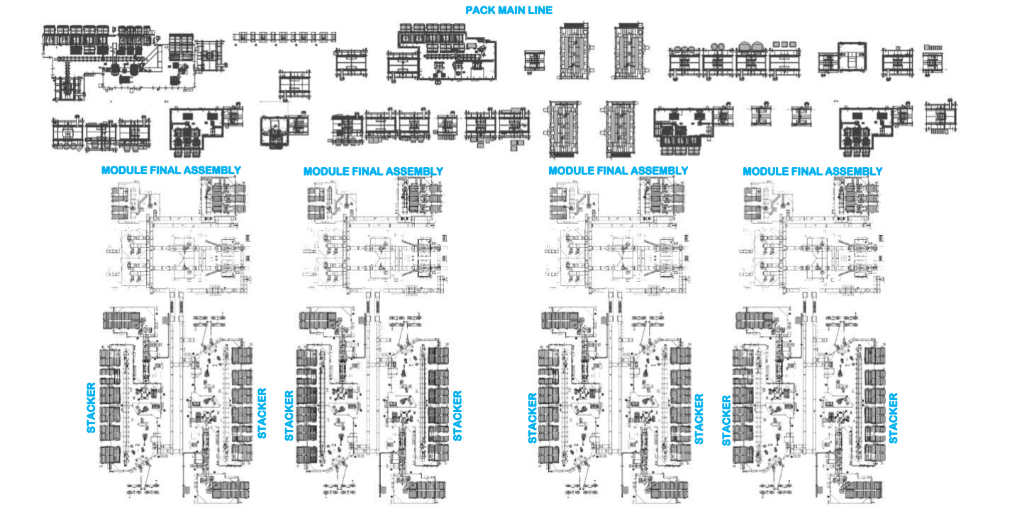
Battery Pack Test System Layout

Slide 30
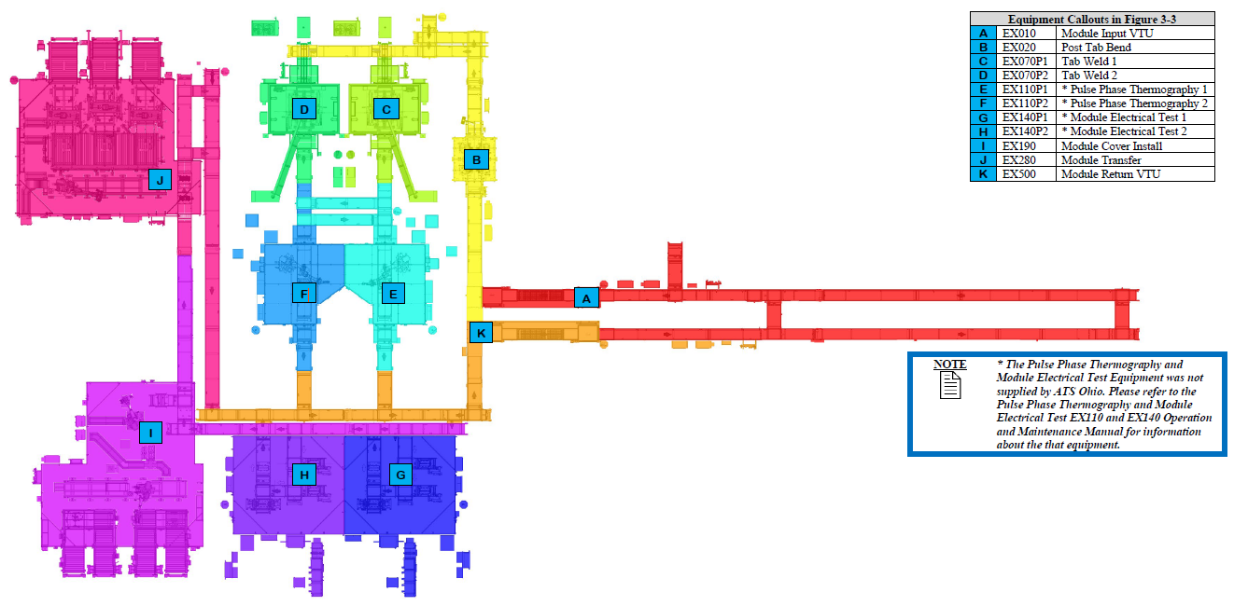
Module Final Assembly Layout

Slide 31
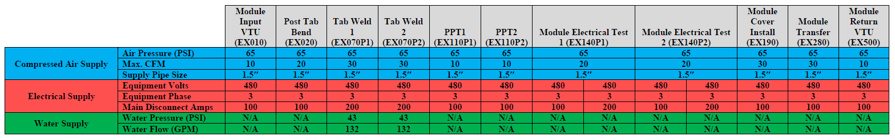
Module Final Assembly Line
Utilities

Slide 32
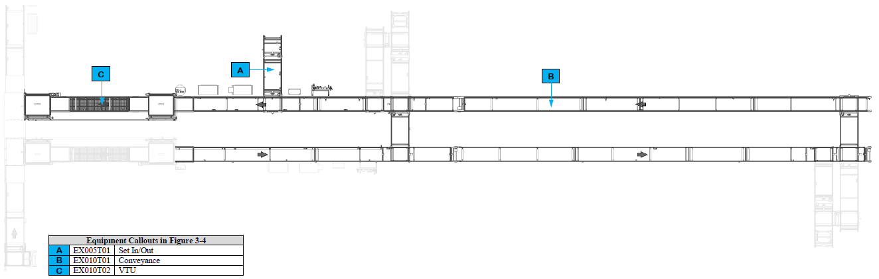
Module Input VTU Equipment

Slide 33
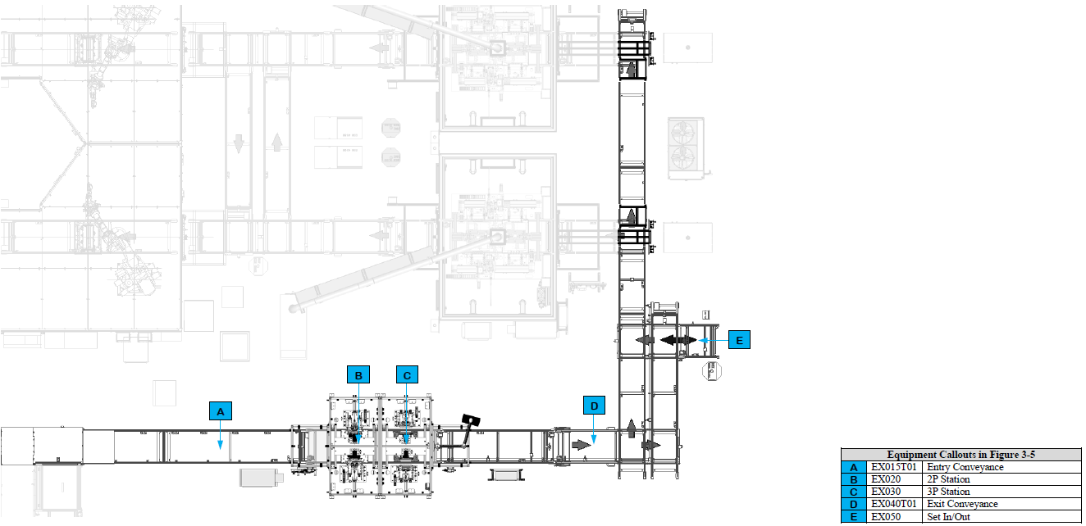
Post Tab Bend Equipment

Slide 34
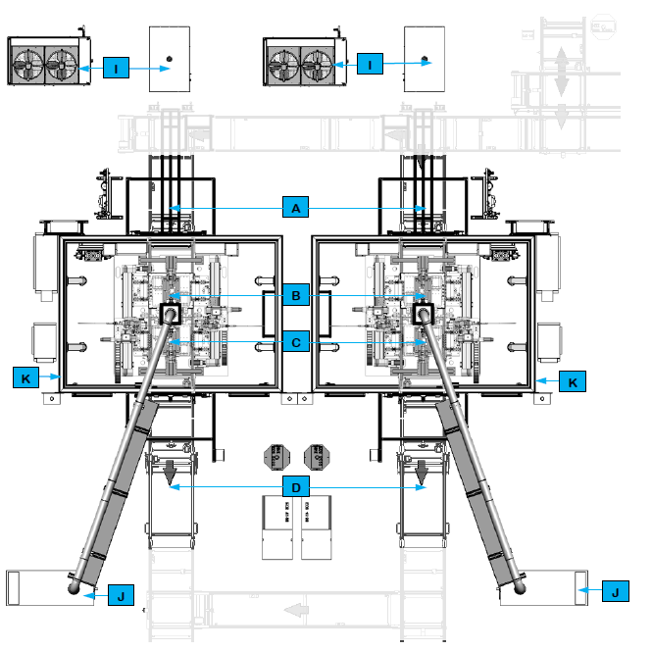
Tab Weld Equipment

Slide 35
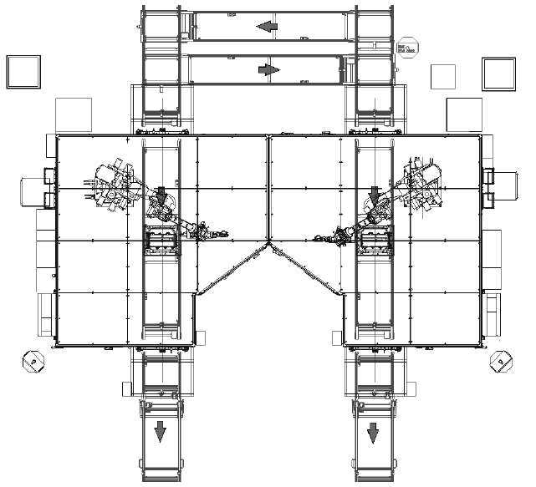
Pulse Phase Thermography Equipment

Slide 36
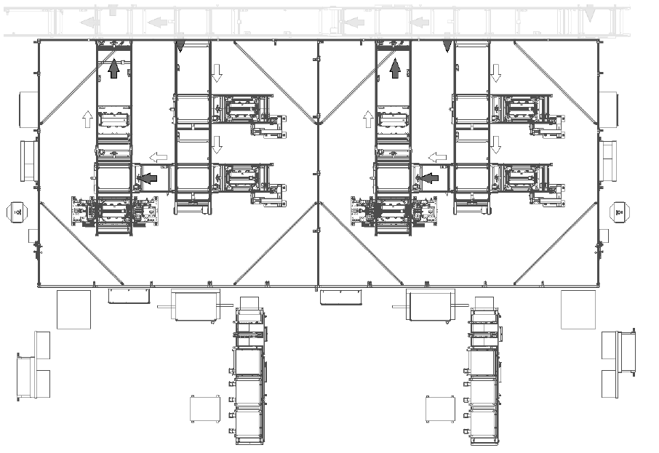
Module Electrical Test Equipment

Slide 37
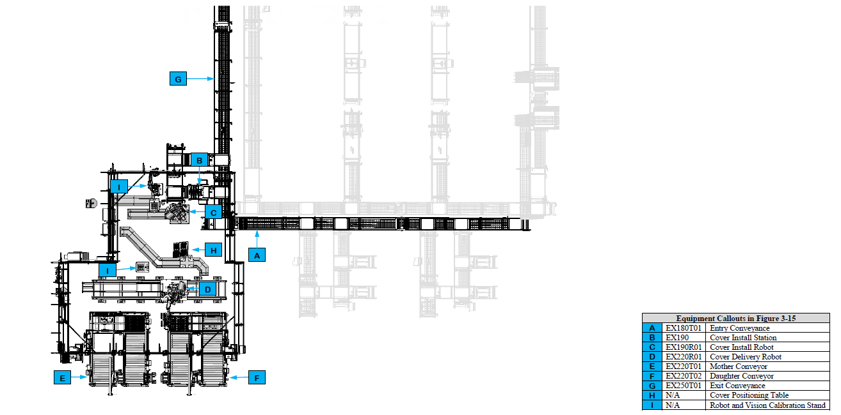
Module Cover Install Equipment

Slide 38
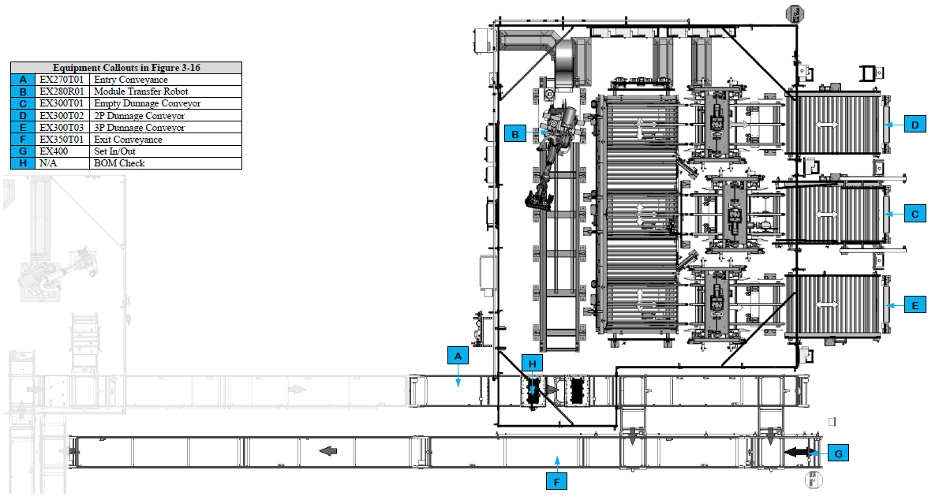
Module Transfer Equipment

Slide 39
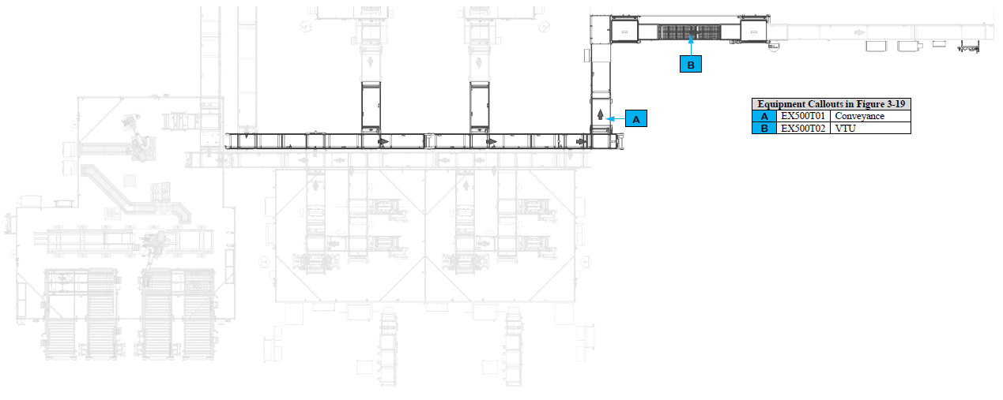
Module Return VTU Equipment

Slide 40
Station Descriptions and Sequence of Operations

Slide 41
Common Equipment

Slide 42
Operator
Interface Devices

Slide 43
Controls and Indicators

Slide 44
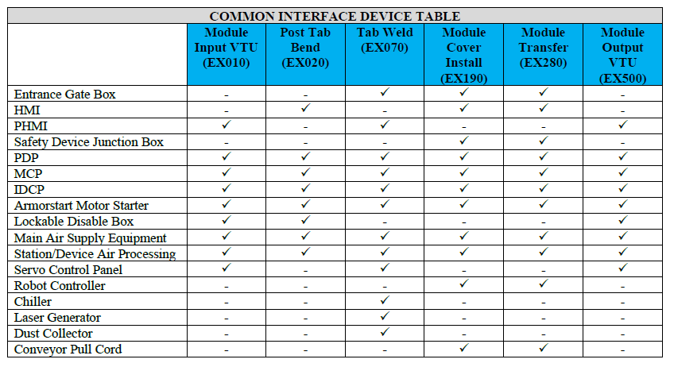
Summary

Slide 45
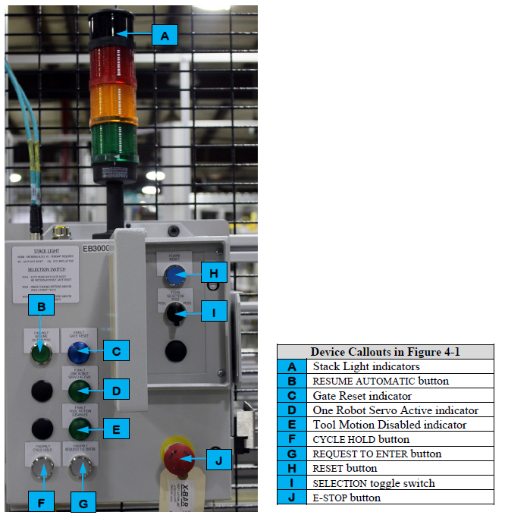
Entrance Gate Box

Slide 46
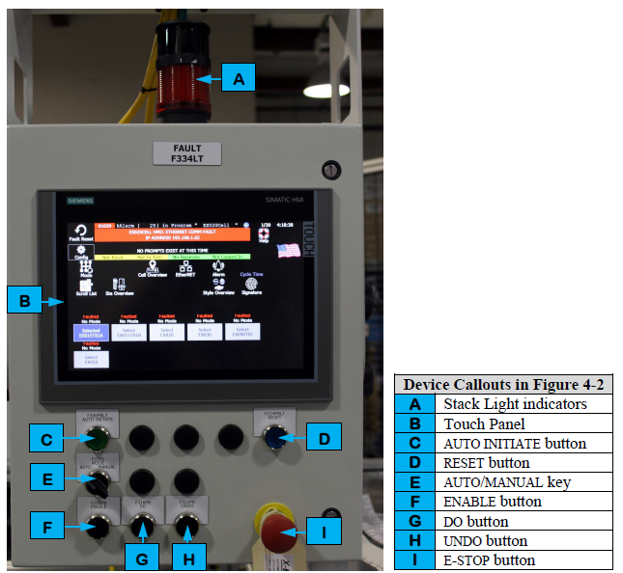
HMI

Slide 47
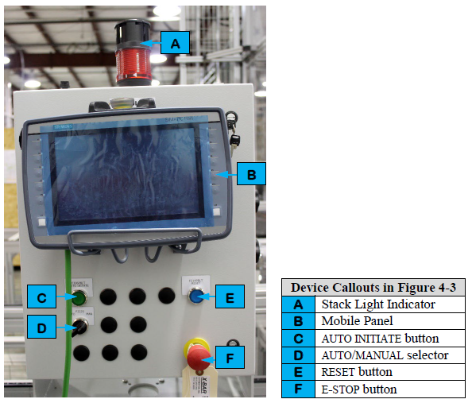
Portable HMI

Slide 48
Safety Device Junction Box
Power Distribution Panel
MCP
Integrated Drive Contractor Panel
ArmorStart Motor Starter
Lockable Disable Box
Main Air Supply Equipment
Station /Device Air Processing Equipment
Servo Control Panel
Robot Controller
Chiller
Laser Generator
Dust Collector
Conveyor Pull Cord

Slide 49
HMI Screens

Slide 50
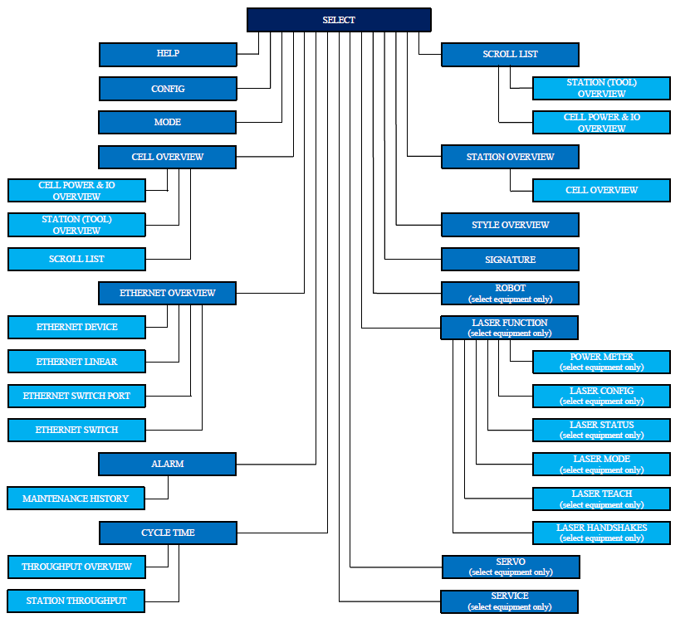
HMI Screen Navigation Paths

Slide 51
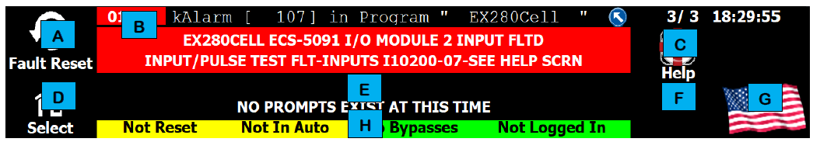
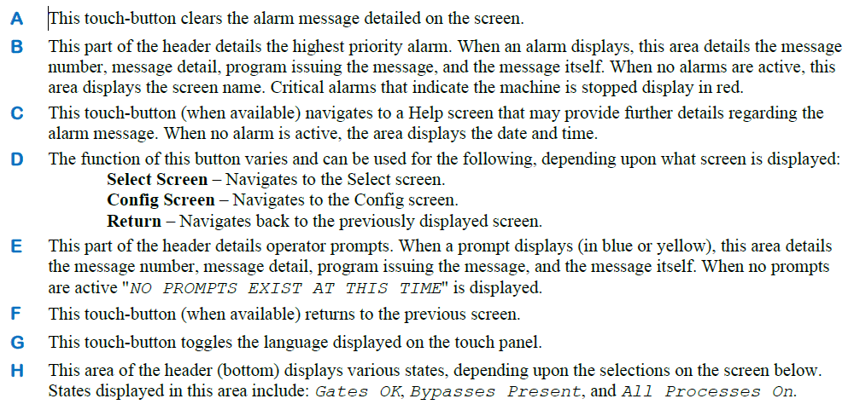
Screen Header

Slide 52
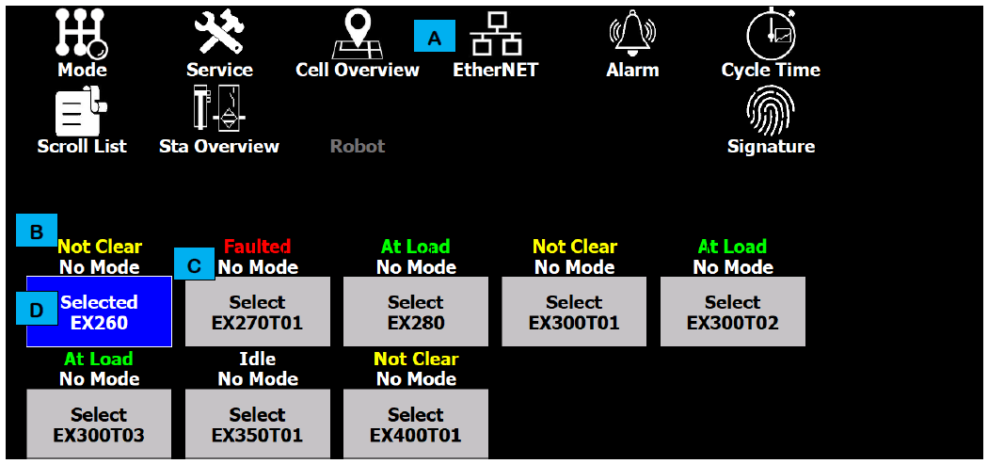
Select Screen

Slide 53
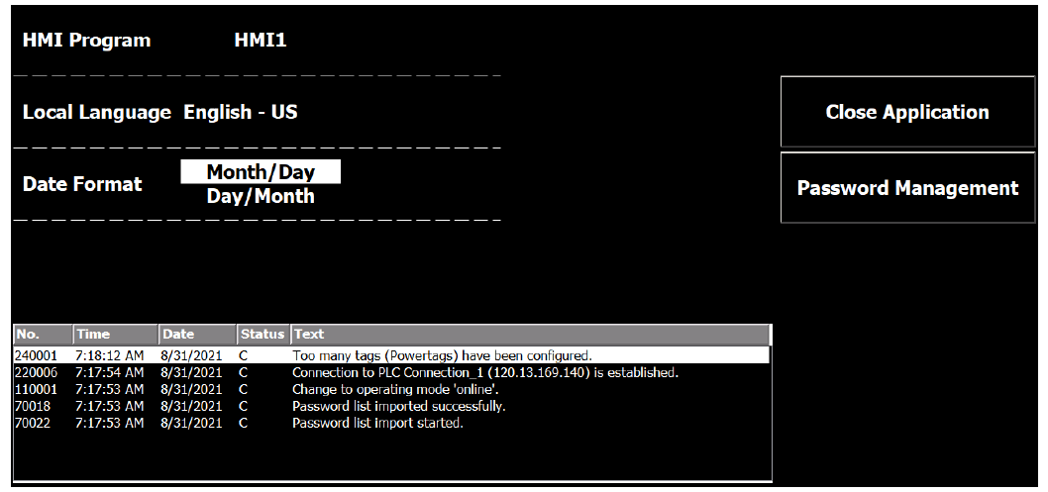
Config Screen

Slide 54
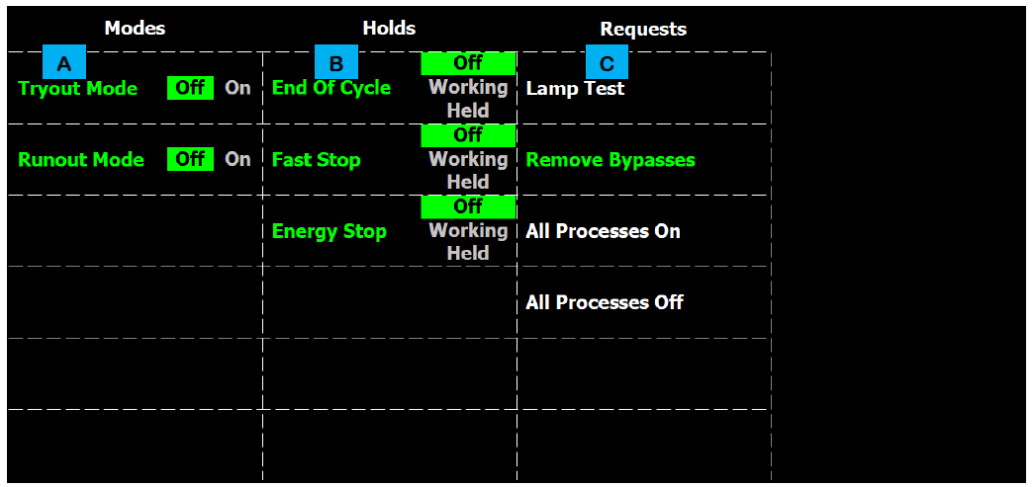
Mode Screen

Slide 55
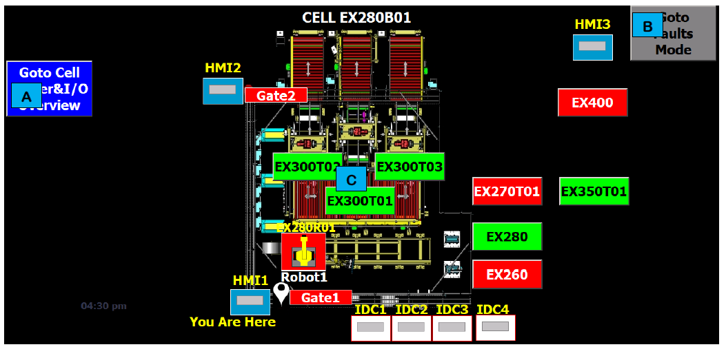
Cell Overview Screen

Slide 56
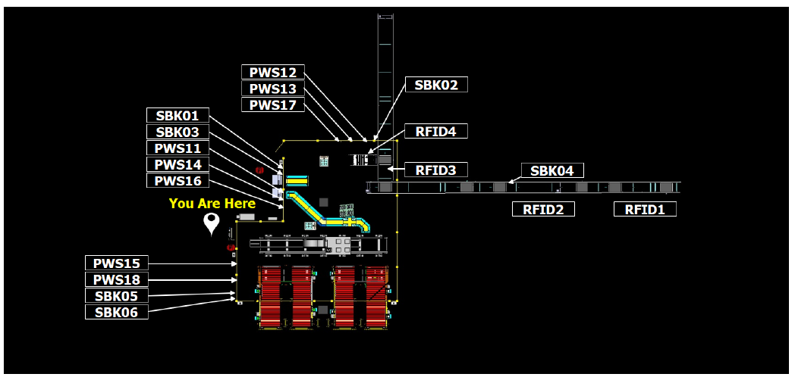
Cell Power and I/O Screen

Slide 57
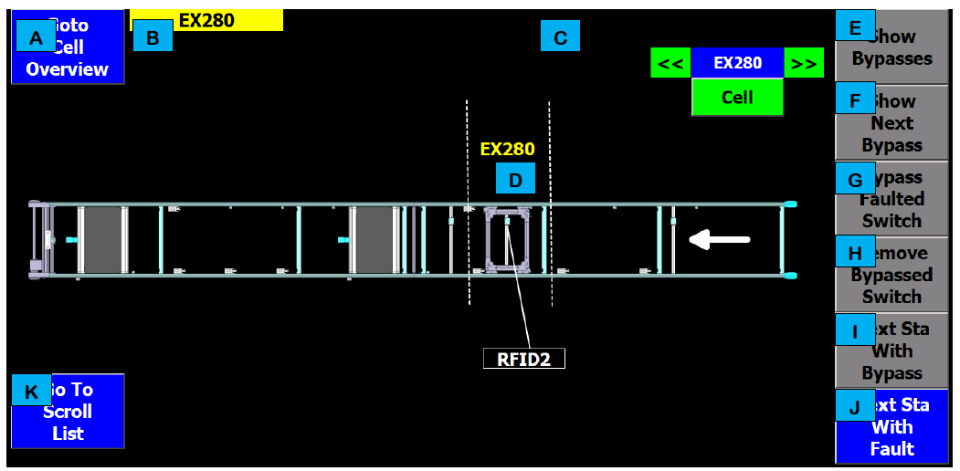
Station (Tool) Overview Screen

Slide 58
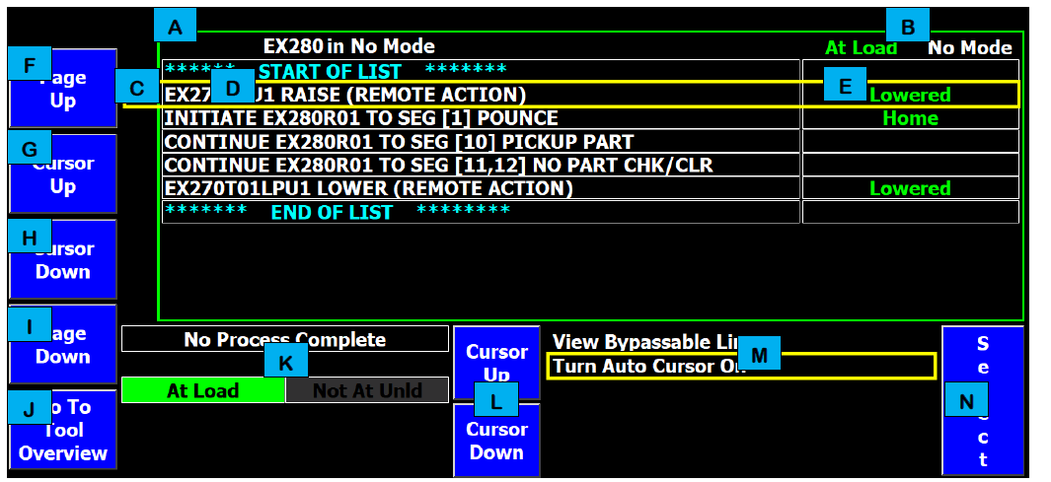
Scroll List Screen

Slide 59
EtherNet Overview Screen

Slide 60
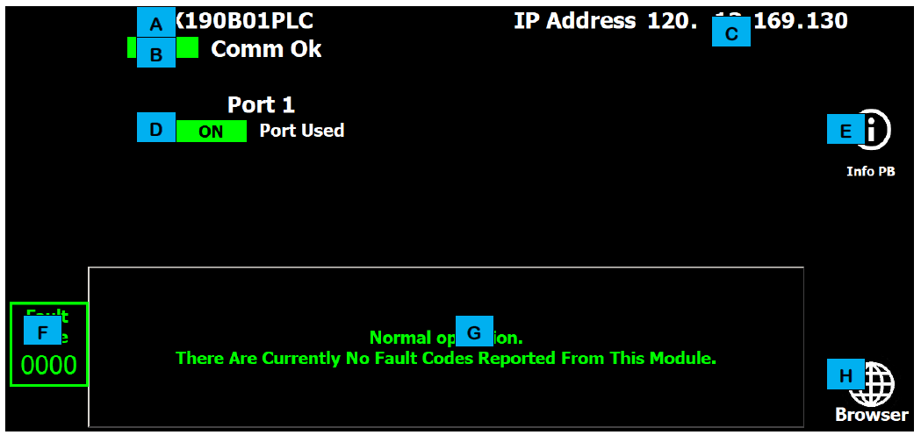
EtherNet Device Screen

Slide 61
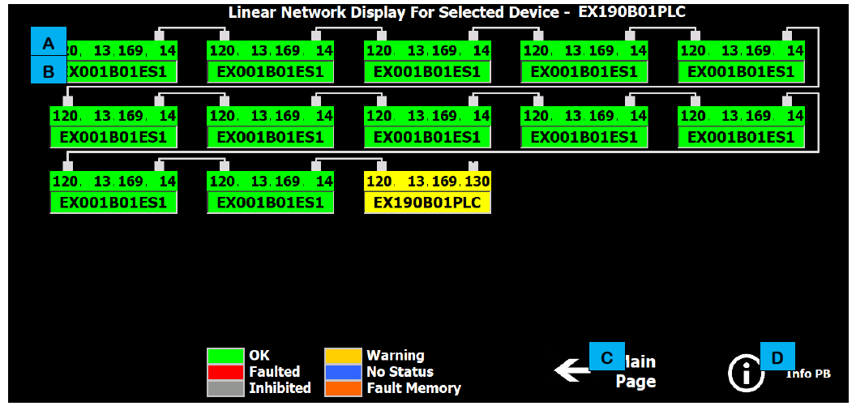
EtherNet Linear Screen

Slide 62
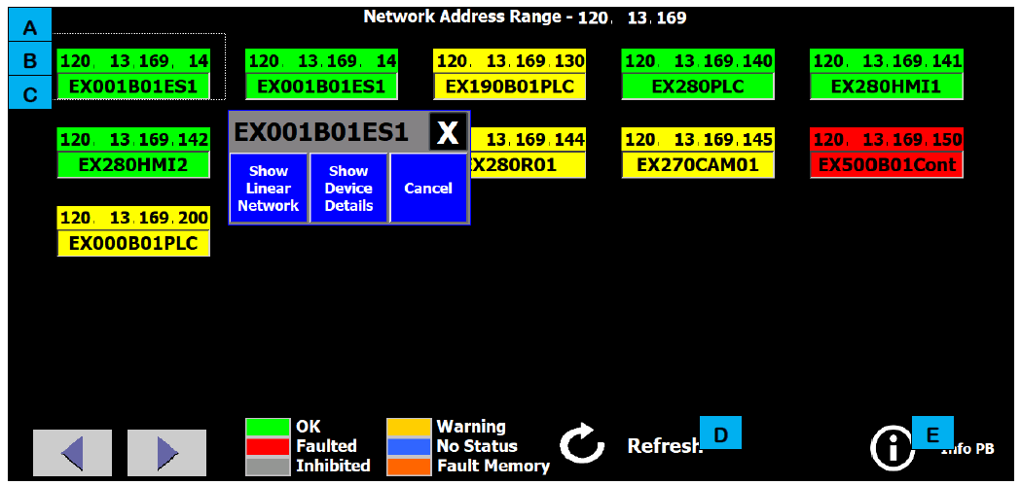
EtherNet Switch Port Screen

Slide 63
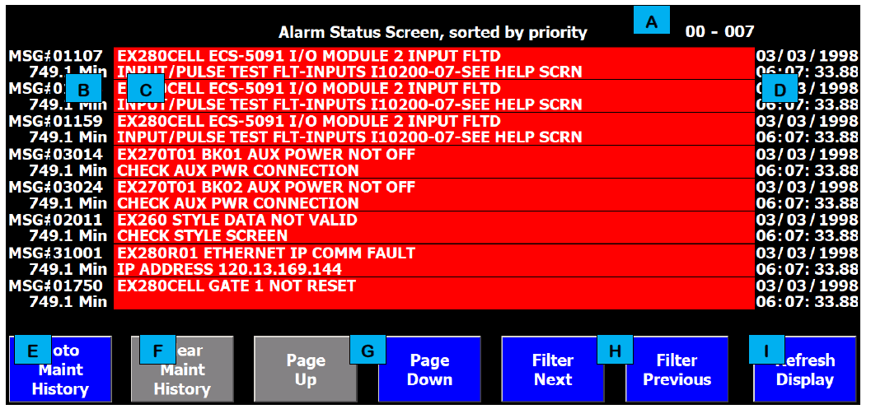
Alarm Screen

Slide 64
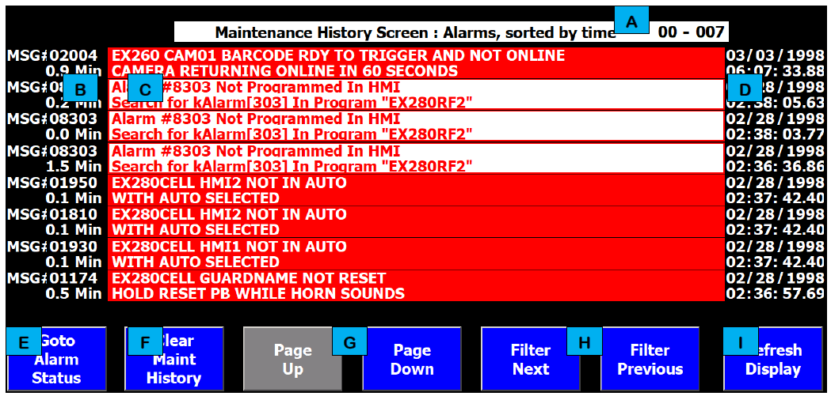
Maintenance History Screen

Slide 65
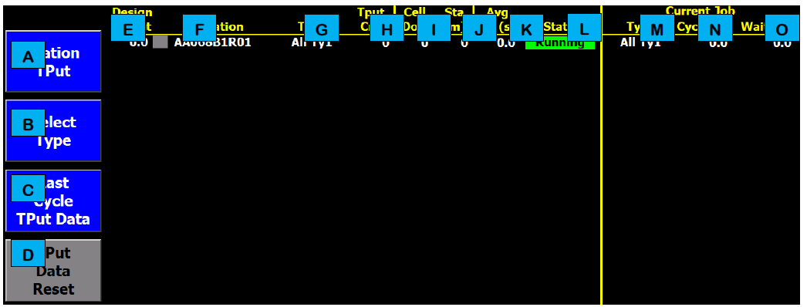
Throughput Overview Screen

Slide 66
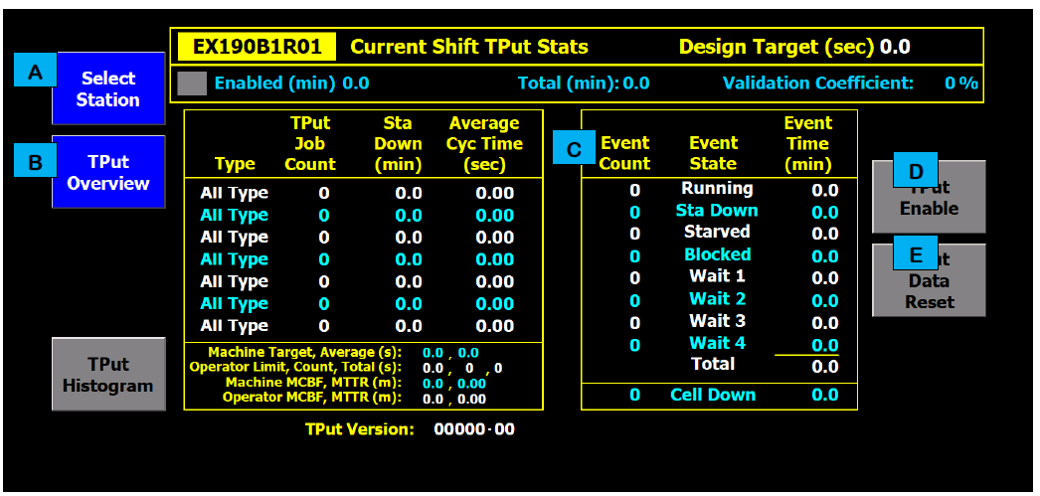
Station Throughput Screen

Slide 67
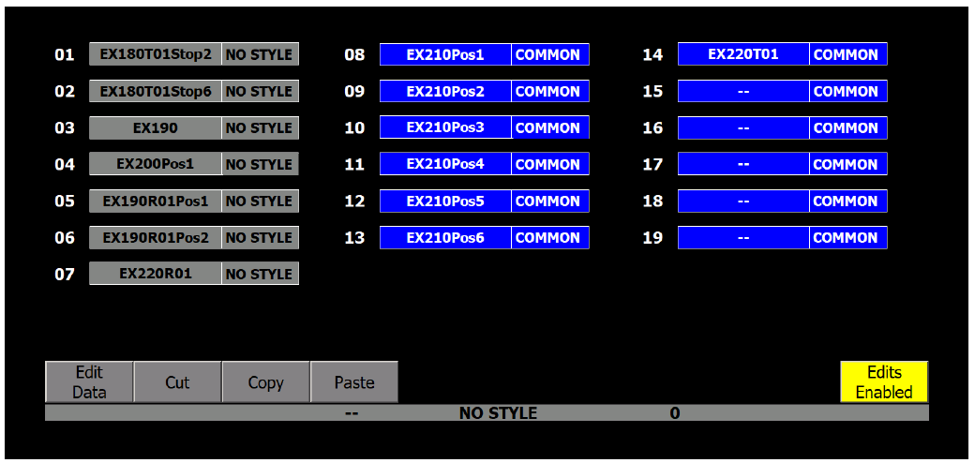
Style Overview Screen

Slide 68
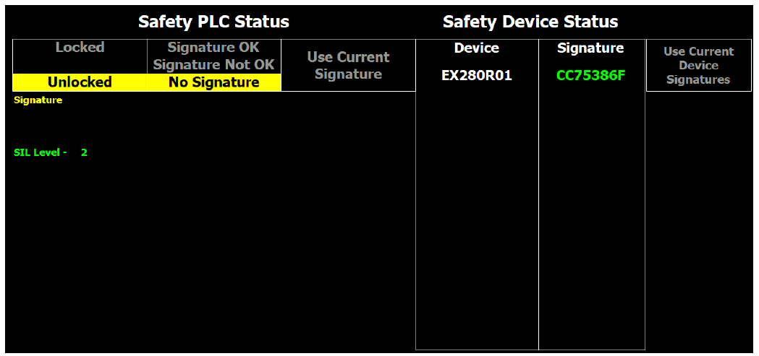
Signature Screen

Slide 69
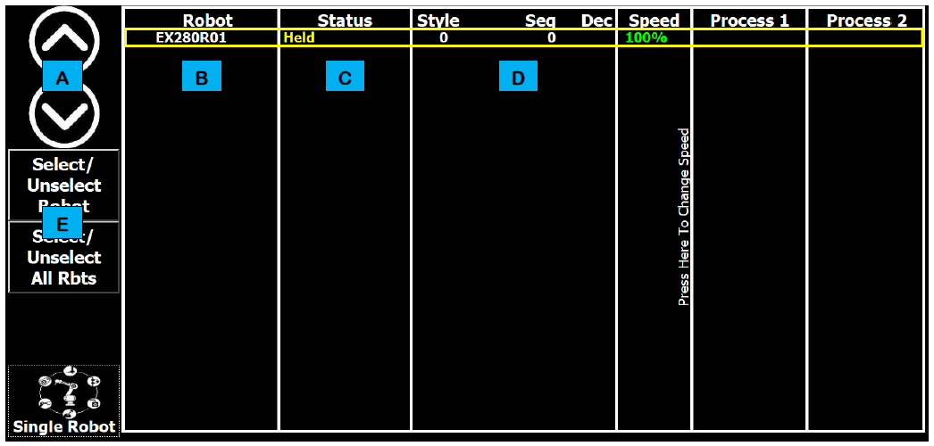
Robot Screen

Slide 70
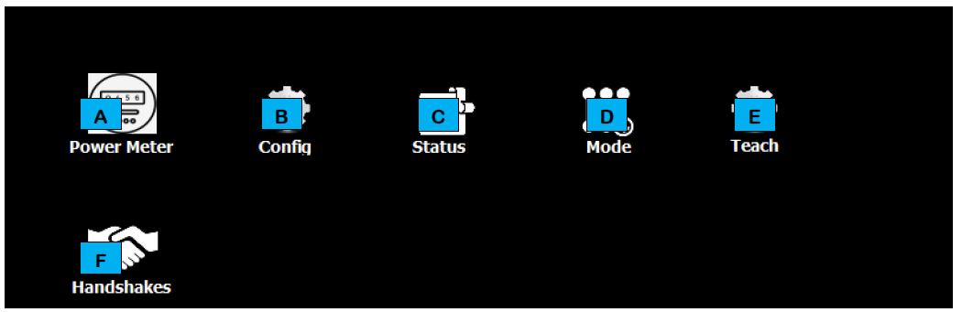
Laser Function Screen

Slide 71
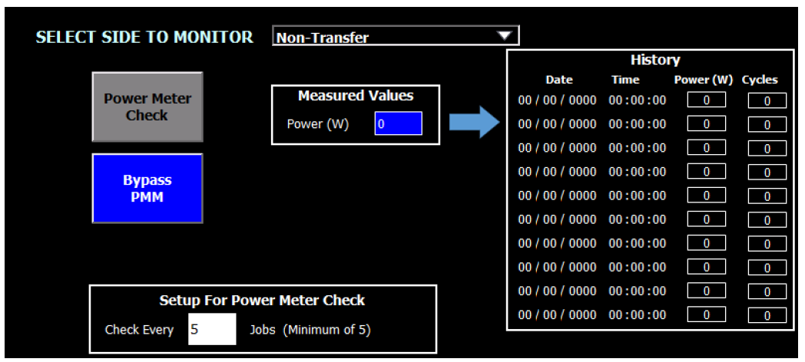
Power Meter Screen

Slide 72
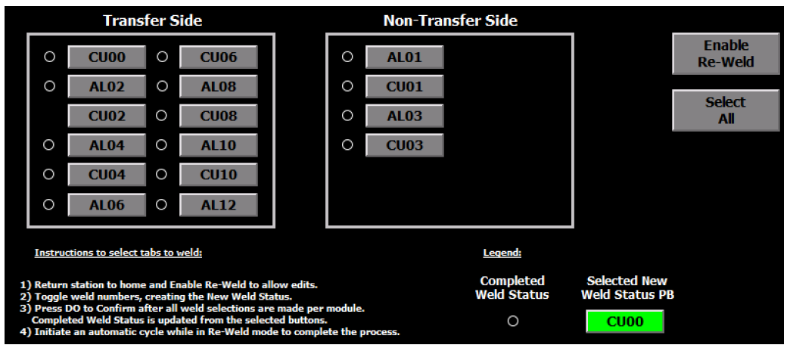
Laser Configuration Screen

Slide 73
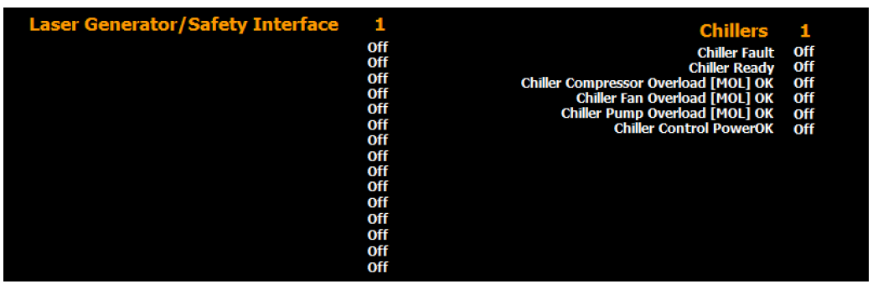
Laser Status Screen

Slide 74

Laser Mode Screen

Slide 75

Laser Teach Screen

Slide 76

Laser Handshake Screen

Slide 77

Servo/VFD Screen

Slide 78

Service Screen

Slide 79
Common Operating
Procedures

Slide 80
Inspecting the Line
Starting an Automatic Cycle
Stopping a Cycle
Cycle Stop
Emergency Stop
Shutting Down

Slide 81
Recovering from an Emergency Stop
Recovering from a Fault
Opening and Closing an Entrance Gate
Loading (or Unloading Components)
Removing Rejects
Reintroducing Parts

Slide 82
Modes of Operation

Slide 83
Hands On
(At the Machine)

Slide 84
HMI Screens

Slide 85
Common Operating
Procedures

Slide 86
Mechanical Drawings
Overview

Slide 87
TIS and TIV
Overview

Slide 88
Questions & Answers

Slide 89
TIS and TIV Overview
(At the Machine)

Slide 90
Questions & Answers

Slide 91
Troubleshooting
and Faults
(At the Machine)

Slide 92
Questions & Answers

Slide 93
Class Wrap-Up
Closing Remarks
Complete Course Evaluations

